Slide 1
How To Use Guide and Toolkit

Slide 2
What do we aim to achieve with the introduction of the Health Passport?
That employees are adequately supported within the workplace across the Trust from the commencement of their employment
That employees returning from redeployment or shielding are adequately supported to continue to work safely
That the Trust meets its duties under the Equality Act 2010 to provide reasonable adjustments for employees providing the impact it has on the service is considered
That the support provided by line managers is consistent across the Trust
What is a reasonable adjustment?
Employers must make reasonable adjustments to make sure workers with disabilities, or physical or mental health conditions, aren’t substantially disadvantaged when doing their jobs.
This applies to all workers, including trainees, apprentices, contract workers and business partners.
What the employer can consider changing:
changing working arrangements, for example the employee’s shift pattern
removing something from the workplace, for example bright lights above the employee’s workstation
providing something in the workplace, for example an accessible car parking space
providing extra or specialised equipment
getting someone in to help, for example a sign language interpreter

Slide 3
What is Access to Work?
Access to Work is a publicly funded employment support programme that aims to help more disabled people start or stay in work. It can provide practical and financial support if you have a disability or long term physical or mental health condition.
Access to Work can also visit your workplace and make assessments on what your employer can do to support you in your role and make recommendations on equipment that you may need.
If you would like more information on Access to Work please contact:
Caitlin New in Risk Management: caitlyn.new@rbchnhs.uk (contact telephone number or is email better?)
More details are here on what support the Access to Work assessment could provide and the eligibility criteria:
https://www.gov.uk/access-to-work

Slide 4
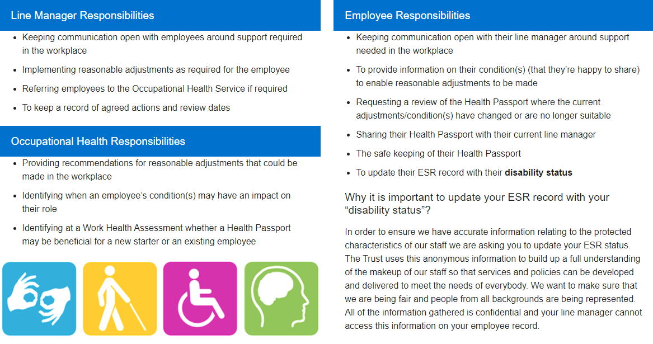

Slide 5
Frequently Asked Questions
What is a Health Passport?
A Health Passport is a confidential document that is completed by an employee who has a physical or mental health condition and who may require temporary or permanent workplace adjustments.
Under the Equality Act 2010 “a person is disabled if they have a physical or mental impairment which has a substantially adverse and long-term effect on their ability to carry out normal day-to-day activities” (Equality Act, 2010).
This document is designed to allow individuals to easily record information about their condition(s) and any reasonable adjustments they may have in place and/or any challenges they might face in the workplace. This is a portable document that is “live”, meaning it can be reviewed and adjusted if the employees needs or role changes within the organisation.
What is meant by ‘Reasonable Adjustments’?
Definition: A feasible alteration that an employer should make to an employee’s role or working environment that would enable anyone with an impairment(s) to continue to carry out their duties without being disadvantaged. The duty to make reasonable adjustments is part of the Equality Act 2010.
Do I have to complete a Health Passport?
The Health Passport is voluntary – it is designed as a supportive document you complete and use as a framework to talk through your health condition with your line manager
Who can help me complete the Health Passport?
Your line manager can access the online toolkit and go through the passport with you.
The pro-ability network can put you in touch with someone who has already completed a passport and can help you.
Notes:
FAQS

Slide 6
Is this confidential?
All discussions about your health and wellbeing are confidential, the health passport is a document you keep control of.
Will this be part of my appraisal?
Your yearly appraisal is an excellent opportunity to discuss your wellbeing and your manager will want to support you in the workplace. Understanding your health and wellbeing will enable them to do this better. You don’t have to wait for your appraisal if you want to discuss your wellbeing.
Do I have to declare I have a disability on my ESR staff record?
It is advisable to update your electronic staff records with your most up to date details. These are confidential records and only visible to you and your line manager. By telling us you have a disability we can ensure we are able to provide the right support to you as a valued employee. If we don’t count you, you don’t count!
Who will be able to see my Health Passport?
It is your choice who sees this document, you can show this to your line manager, your colleagues, in addition to Occupational Health.
If I change jobs do I have to show this to my new manager?
The Passport can help your new manager understand any support or reasonable adjustments you may need in your new role.
Do I need to share the details of my health condition with my colleagues?
You may need support from your team to ensure you can stay safe and well at work. E.g. awareness of allergies, reaction to medication, light, sound, changes in temperature, who to contact in an emergency.
How do I update my passport?
You can update your passport at any time you wish.
Where is my passport stored?
It is your document and you can keep this as a paper copy or store electronically. We would recommend if you are storing this on a shared computer at work you protect with a password.
Notes:
FAQS

Slide 7
Who can help me with the Health Passport?
The Pro Ability Staff Network is here to help you if you work at Bournemouth, Christchurch or Poole Hospitals.
We can arrange to connect you with a member who has experience of completing a health passport and can help you start yours.
Email: diversityandinclusion@rbch.nhs.uk
Or visit our pages on the intranet. (you can see these on the external website too and use browse aloud)
Additional support:
Debbie Detheridge Diversity and Inclusion Lead debbie.detheridge@rbch.nhs.uk 01202 704401
Marie Cleary, staff experience and wellbeing lead marie.cleary@poole.nhs.uk 01202 442820
Occupational Health Department
Occupational.health@rbch.nhs.uk Telephone: 01202 704513
Human Resources:
Caroline Gibbs caroline.gibbs@rbch.nhs.uk
Mandy Craig mandy.craig@poole.nhs.uk, ex 8433 and Sally Rose sally.rose@poole.nhs.uk, ext 2165.
Medical Staffing:
Sarah Davies sarah.davidson@rbch.nhs.uk
Sally Rose sally.rose@poole.nhs.uk
Risk management:
Caitlin New caitlin.new@rbch.nhs.uk Telephone: 01202 704039
Staff side reps
Contact your union or professional body representative
Freedom to speak up Guardians
freedomtospeakup@rbch.nhs.uk
freedomtospeakup@poole.nhs.uk
Telephone: 01202 704220
Notes:
FAQs

Slide 8
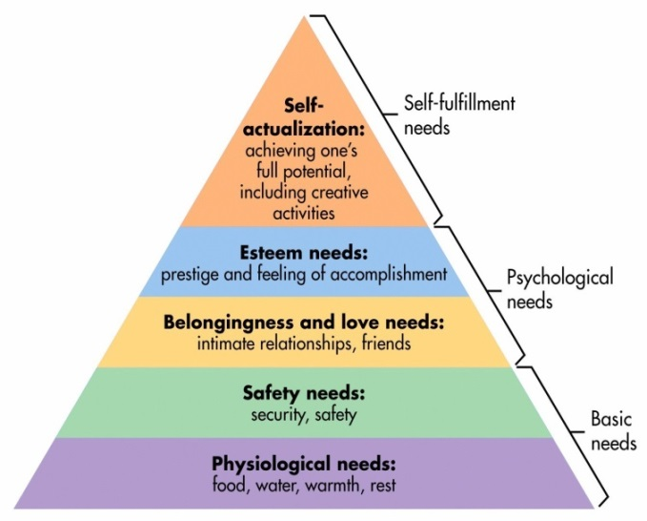
How to have compassionate conversations when carrying out risk assessments
This information is designed to support line managers in having compassionate and considerate conversations with staff undertaking the Covid-19 Risk Assessment. We know staff with disabilities or underlying health conditions have found this pandemic particularly hard due to being redeployed, working from home or shielded. This may be the first time they have had to declare their condition to their employer or acknowledge the limitations this may place on them to support themselves, colleagues and patients.
Health and Wellbeing - Maslow Hierarchy of Needs during COVID-19
Physiological - The current state of our world right now has caused many people to be motivated by more basic needs than they were before this pandemic. Encourage all your staff to look after themselves – body and mind, have conversations that allow individuals to explore their best fit in terms of their health and wellbeing.
2. Safety Needs - Given the impact upon staff with disabilities and long term health conditions, support before, during and after the pandemic will be crucial to their long term health and wellbeing. Do educate yourself about the facts and stick to those facts when feeding back the risk assessment. It is important not to validate or encourage fears born out of hearsay and speculation.
Notes:
managers toolkit: compassionate conversations

Slide 9
Compassionate conversations
3. Social Needs – Ensure colleagues and other team members are fully informed and sensitive to the needs of differently abled staff during the pandemic. Now, more than ever, is the time to instil the importance of team support and cohesiveness. Do provide opportunities for staff to come together to share experiences and concerns. Avoid the temptation that just because a member of staff hasn’t come forward to discuss concerns with you, to assume they don’t have any.
4. Esteem Needs - During this time, these types of needs might not be able to be met because staff may be focused on meeting more basic needs. It is important that you encourage, praise and thank staff for their efforts during this time. Do encourage team members to support one another in relation to ability and contribution on a shift or interactions with patients.
5. Self-actualization - This need occurs when all other needs are met sufficiently. In the light of the current crisis that most of the nation is facing right now, the majority of people are not able to focus on these higher-order needs. Do be creative about how you can give back to and help others who are struggling.

Slide 10
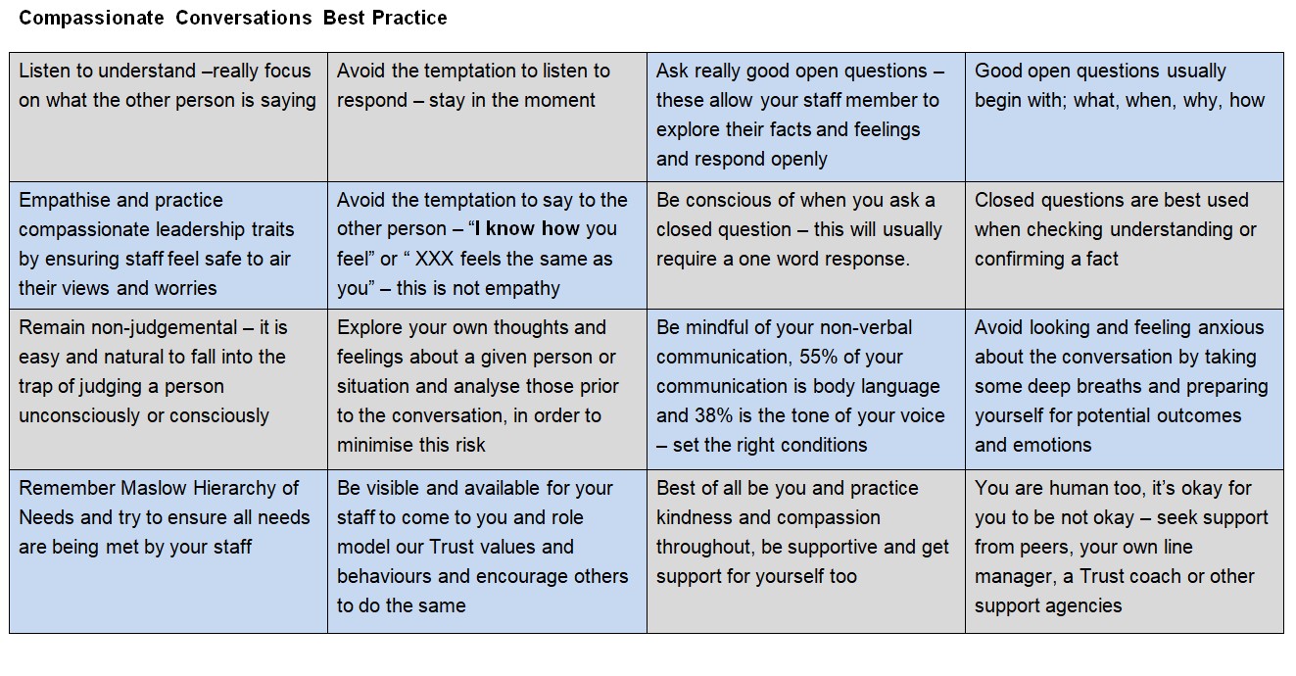
Notes:
managers toolkit: ompassionate conversations

