Slide 1

December 16th 2021
Master Version 2
Care Groups and Operations
Structure

Slide 2
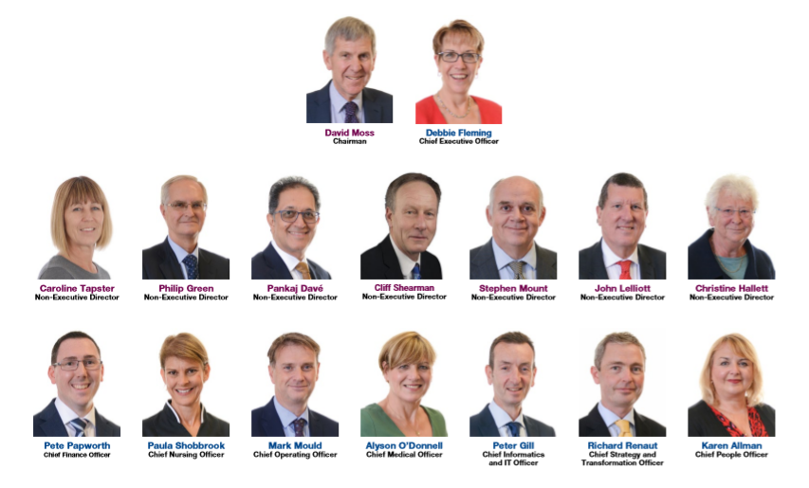
Our Board

Slide 3
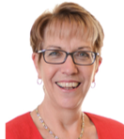
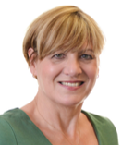
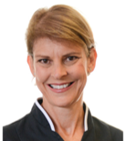
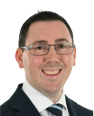
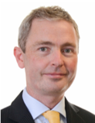
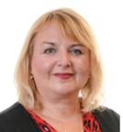
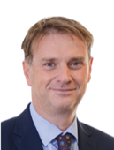
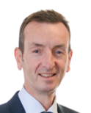
Council of Governors
Board of Directors
(Chairman, Executive Directors, Non-Executive Directors)
Chief Executive
Debbie Fleming
Corporate / Executive Team
Chief Medical Officer
Alyson O’Donnell
Medical – Responsible Officer,
Governance, Risk & Safety
Medical Examiners
Clinical Claims and Inquests (inc. Learning from Deaths)
Caldicott Guardian
Chief Nursing Officer
Deputy Chief
Executive
Paula Shobbrook
Quality, Governance & Risk (inc Clinical Audit & Effectiveness, Risk Management, Quality Assurance – CQC, Health & Safety)
Patient Experience (inc Chaplaincy, Complaints, PALS & Volunteers)
Clinical Practice Infection Control
Safeguarding Adults & Children
Chief Finance Officer
Pete Papworth
Finance
Commercial Services
Business Intelligence
Chief Strategy &
Transformation Officer
Richard Renaut
Estates (inc Clinical Engineering)
Strategy & Transformation
Quality & Improvement
Chief People Officer
Karen Allman
Communications
Education & Training
HR Operations / HR Strategy
Organisational Development
Workforce Development, Strategy & Planning
Occupational Health
Chief Operating Officer
Mark Mould
Surgical / Medical / Specialties Care Groups
Operations, Flow & Facilities
Partnership, Integration & Discharge
Emergency Planning
Operational Performance, Assurance & Delivery
Chief Information &
IT Officer
Peter Gill
IT / Telecoms
Health Records
Information Governance

Slide 4
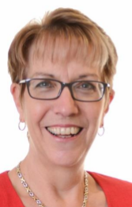

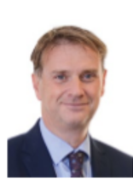
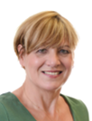
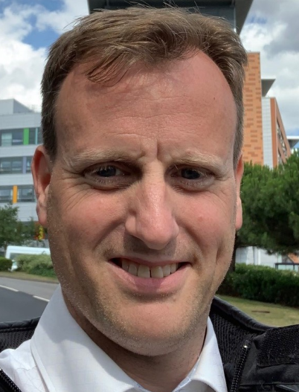

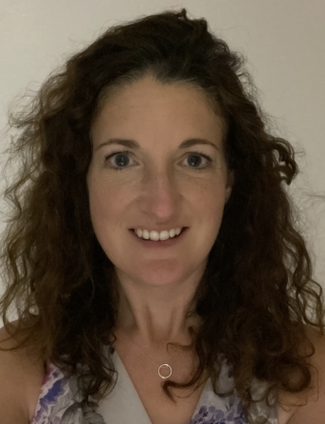
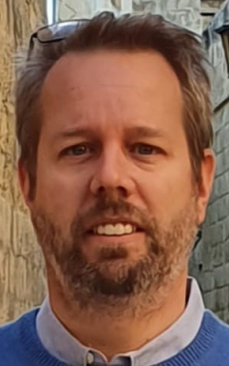


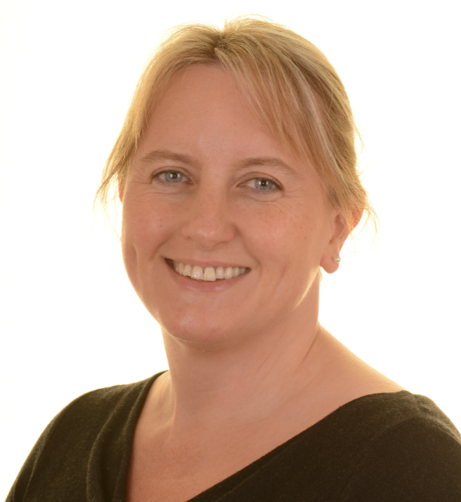


University Hospitals Dorset Care Group Structure
Professional Accountability
Group Directors of Nursing to Chief Nursing Officer
Medical Directors to Chief Medical Officer
Managerial Accountability
Through Group Director of Operations to Chief Operating
Officer
Debbie Fleming
Chief Executive
Paula Shobbrook
Chief Nursing Officer/ Deputy Chief Executive
Mark Mould
Chief Operating Officer
Alyson O’Donnell
Chief Medical Officer
John Coleman Interim Deputy COO
MEDICAL
SURGICAL
SPECIALTIES
Alex Lister
Group Director of Operations Medicine (GDO)
Abigail Daughters
Group Director of Operations Surgical
(GDO)
Sarah Macklin
Group Director of
Operations
Specialties (GDO)
Tristan Richardson
Group Medical Director (GMD)
Sue Reed
Group Director of Nursing (GDN)
Rob Howell
Group Medical Director (GMD)
Madeleine Seeley
Group Director of Nursing(GDN)
Daniel Webster
Group Medical Director (GMD)
Claire Rogers
Group Director of Nursing (GDN)

Slide 5
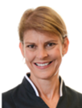
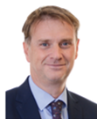

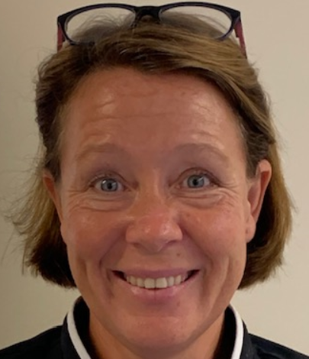
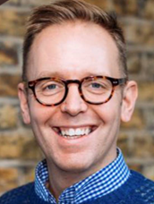
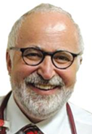
Corporate Site Based Support
Chief Medical Officer (CMO)
Chief Nursing Officer (CNO)
Chief Operating Officer (COO)
Ruth Williamson
Deputy Chief Medical
Officer
Fiona Hoskins
Deputy Chief Nursing
Officer
John Coleman
Deputy Chief Operating
Officer
Matt Hodson
Deputy Chief Nursing
Officer
Matt Thomas
Deputy Chief Medical
Officer
Bournemouth and Christchurch sites responsibility
Poole site responsibility

Slide 6
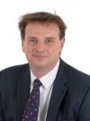
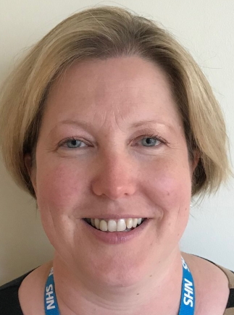


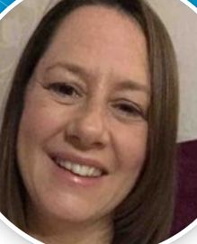


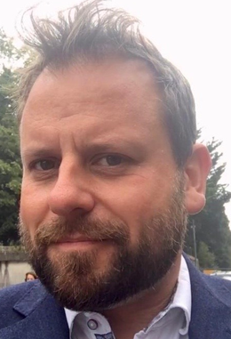


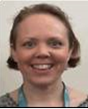
Operations Team Structure
Operational Accountability
Chief Operating Officer
Mark Mould
Operational Responsibility
Group Director of
Operations
Specialties / Surgical
/ Medicine
Interim Deputy COO
John Coleman
UHD Operational Delivery
Associate Director - Operations, Flow and Facilities
Sophie Jordan
Associate Director - Partnership, Integration & Discharge
Cherry McCubbin
Associate Director of Operational Performance, Assurance and Delivery
Judith May
Head of Emergency Planning & Response
Libby Beesley
Associate Director of Operational Performance, Assurance & Delivery – Cancer Care
Alison Ashmore
Head of Operations, Flow & Capacity Planning
Stuart Wersby
Head of Operations, Flow & Facilities Stuart Willes
Head of Access
Jonathan Wright
Directorate Manager - Facilities
Mike Richardson
Directorate Manager -
Discharge Services
Val Horn
Programme Implementation Manager - Integrated Care
Elizabeth Warrington

Slide 7
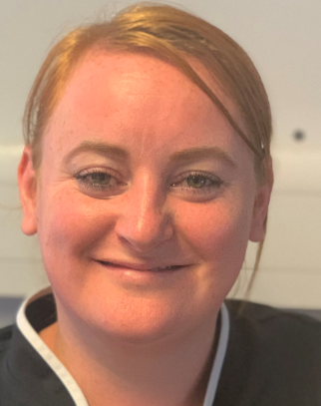
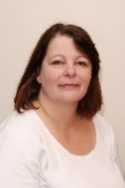

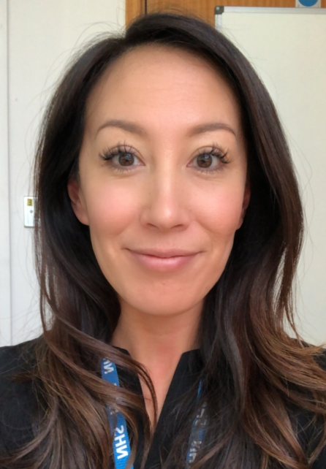

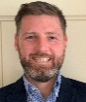
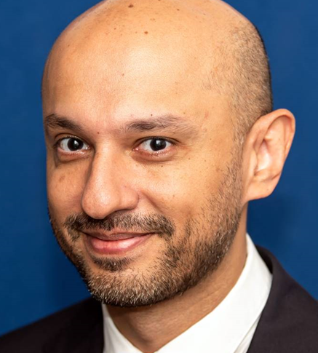
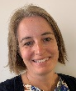



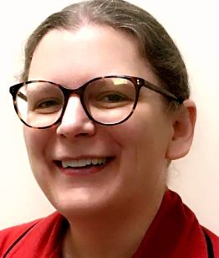
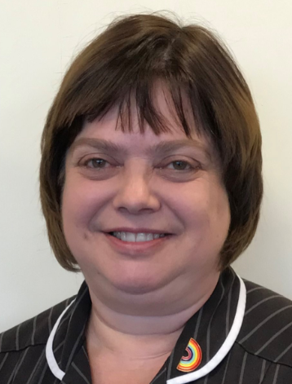





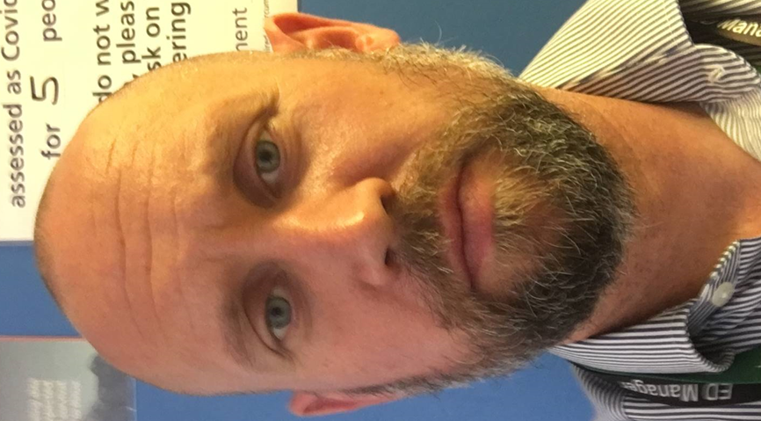
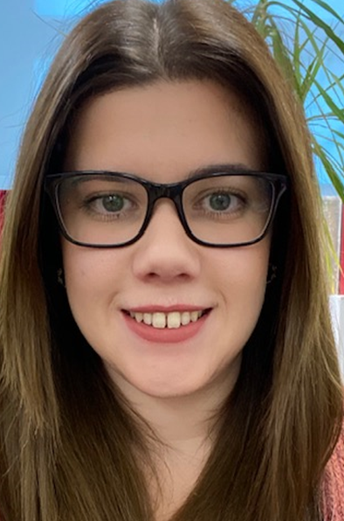


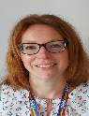
Medical Care Group
Group Director of Operations
Alex Lister
Group Director of Nursing
Sue Reed
Group Medical Director
Tristan Richardson
Head of Nursing & Professions
Leanne Aggas
Deputy Group Director of
Operations Sue Whitney
Emergency and Urgent Care
Acute and Ambulatory Medicine
Cardiology and Renal
Medical Specialties
Older People’s Medicine Neurosciences
Accident & Emergency Department
Urgent Treatment Centre
Acute Medicine
Ambulatory Care
Treatment Investigation Unit
Cardiology
Renal Medicine
Respiratory Medicine
Gastroenterology
Diabetes and Endocrine
Dermatology
Rheumatology
Older Peoples services
Stroke
Brain Injury Unit
Neurology
Neurosciences
General Manager
Toby Mulvey Leaving Late Dec –Recruiting
General Manager
Rohana Lustig – Recruiting Mat cover 12/12
General Manager
Gemma Brittan
Clinical Director
Harry Adlington
Clinical Director
Robin O’Gorman
Clinical Director
Jehangir Din
Clinical Director Georgina Page
Clinical Director
Becky Jupp
Senior Matron
Bruce Hopkins
Senior Matron
Jody Bryant
Senior Matron
Trudi Ellis
Senior Matron
Sarah Gilling
Matron
Georgina Bianchi
Matron
Mel Ivory
Matron
Nikki Manns
Matron
Karen Bowers
Matron
Michelle Richards/
Kate Bond
Deputy General
Manager
Recruiting
Deputy General
Manager
Rick Bradley
Deputy General
Manager
Kaye Woodward
Matron
Jo Maple-Roberts
Matron
Troy Welch
Professional Accountability
Matrons to Senior Matrons through to Group Director of Nursing
Clinical Directors to Group Medical Directors
Deputy General
Manager
Nicki Walsh
Deputy General
Manager
Morwenna Gower

Slide 8
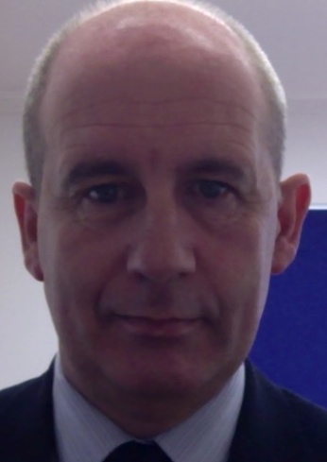

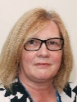


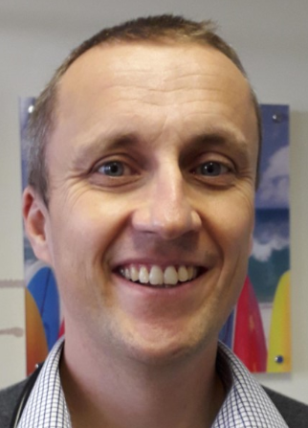
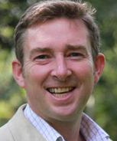

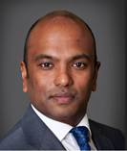
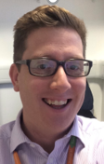

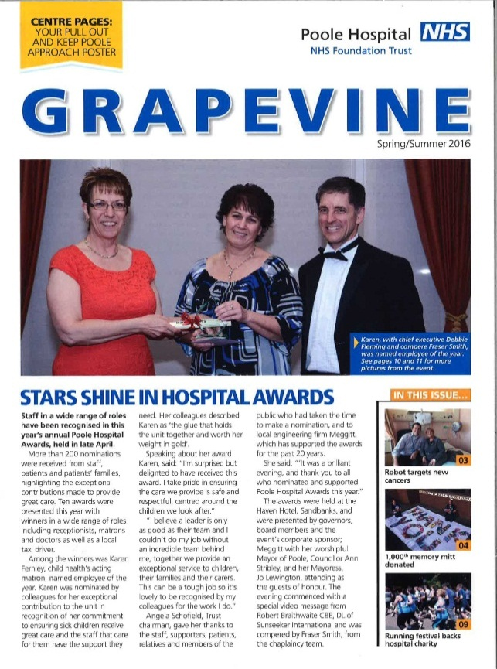
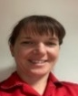
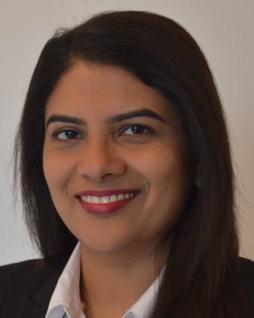
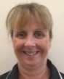



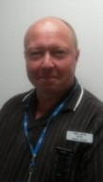
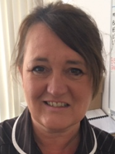
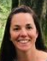






Specialties Care Group
Group Director of Operations
Sarah Macklin
Group Director of Nursing
Claire Rogers
Group Medical Director
Daniel Webster
Deputy Group Director of
Operations Darren Jose
Child Health Directorate
Women’s Health
Directorate
Cancer Care Directorate
Radiology and Pharmacy
Clinical Support Directorate
Pathology Directorate
Acute Paediatrics
CDU/NICU
Community Paediatrics
Maternity, Obstetrics
Gynaecology
Haematology, Oncology
Radiotherapy, Brachytherapy
Palliative Care & Hospices
Radiology and Imaging
Pharmacy
Outpatients
Therapies
Research & Development
Pathology Services
Pathology Network
General Manager
Jo Blackwell
General Manager Mandy Tanner
Head of Imaging
James Knowles
Deputy GDoO
Darren Jose
Head of Service – One Dorset Pathology
Stephen Harding
Clinical Director
Mark Tighe
Clinical Director
Alex Taylor
Clinical Director Maxine Flubacher
Clinical Director Radiology
Ravi Ayer
Clinical Director Outpatients
Jonathan Marks
Head of Pathology
Paul Massey
Senior Matron
Karen Fernley
Associate Director of Midwifery
Lorraine Tonge
Senior Matron
Marie Miller
Deputy ADP
Steve Bleakley
Outpatients Directorate
Manager
Michele Roberts
Clinical Director
Sreekala Sreehari
Palliative Care Lead Nurse
Louise Pennington
Deputy DP
Nick Bolton
Outpatients Matron
Dawn Spriggs
Professional Accountability
Matrons to Senior Matrons through to Group Director of Nursing
Clinical Directors to Group Medical Directors
Head of Therapies
Katherine Armitage
Matron NICU
Daniel Lockyer
Matron
Belinda Hewett
Matron
Daniel Bundy
Deputy GM
Child Health
David Hannington
Deputy GM
Women’s Health
George Floyd
Deputy General Manager
Sian Williams
Clinical Director
Research & Innovation Terry Levy
Head of Research
Laura Purandare
(mat cover Alex Jones)

Slide 9


























Surgical Care Group
Group Director of Nursing
Madeleine Seeley
Group Director of Operations
Abigail Daughters
Group Medical Director
Rob Howell
Head of Nursing & Professions
Stephen Flatt
Deputy Group Director of
Operations Mark Major
Surgery Directorate
Trauma and Orthopaedics Directorate
Head and Neck Directorate
Anaesthetics Directorate
Private Health UHD
GI Surgery, Emergency Surgery
Breast, Endocrine & Skin Surgery,
Vascular Surgery
Dorset Prosthetics Centre
Urology,
Surgical Ambulatory care
Trauma
Fracture Clinics
Elective Orthopedics
Ophthalmology
ENT
Oral and Maxillofacial Surgery
Orthodontics
Reconstructive Dentistry
Theatres
Critical Care
Anaesthetics
Pre-Operative Medicine
Sterile Services
Private Patient Services
General Manager
Nichola House
General Manager
John West
General Manager
Barry Alborough-Duell
Deputy GDO
Mark Major
Clinical Director
Emma Bromwich
Clinical Director
Paul Pavlou
Clinical Director
Mahesh Ramchandani
Clinical Director
Richard Green
Private Patient Services Manager
Jo Clothier
Senior Matron
Louise Coll
Senior Matron
Sue Davies
Senior Matron
Minnie Klepacz
Directorate Managers
Louise McGraw (RBH)
Andrew Ward (PH)
Medical Advisory Committee Chair
Martin Schuster-Bruce
Matron
David Wyman Ambulatory/Day Case
Senior Matron
Eoin Scott - Critical Care
Professional Accountability
Matrons to Senior Matrons Professional Heads through to Group Director of Nursing
Clinical Directors to Group Medical Directors
Matron
Cathy Cocorachio
Matron
Lucy Merrifield
Senior Matron
Clare Bone - Theatres
Matron
Deborah Straw
Matron
Ruth Dodgson -
Critical Care
Will Blackman - Theatres
Deputy General
Manager
Janet Biles
Deputy General
Manager
Faye Hersey
Deputy General
Manager
Charlotte Freeman- laurence

Slide 10
UNIVERSITY HOSPITAL DORSET - CLINICAL CARE GROUP STRUCTURE
Medical Care
Group
Surgical Care Group
Specialties Care Group
Operations
Emergency and Urgent Care Directorate
Accident & Emergency Department
Emergency Admissions
Urgent Treatment Centre
Surgery Directorate
GI Surgery
Emergency Surgery
Breast, Endocrine & Skin Surgery
Vascular Surgery
Dorset Prosthetics Centre
Urology
Surgical Ambulatory care
Cancer Care Directorate
Haematology/Oncology
Radiotheraphy Brachytherapy
Palliative Care /Hospices
Operations, Flow & Facilities
Clinical Site Management
Clinical Site Teams
Hospital at night
Resuscitation & Outreach
Discharge lounge
Acute and Ambulatory Medicine Directorate
Acute Medicine
Ambulatory Care
Treatment Investigation Unit
Child Health Directorate
Acute Paediatrics
Child Development Unit
NICU
Community Paediatrics
Anaesthetics Directorate
Theatres
Critical Care
Anaesthetics
Peri-operative Medicine
Sterile Services
Facilities
Catering
Portering & Security
Housekeeping/Cleaning
Patient Transport logistics
Patient Affairs/General Office
Cardiology and Renal
Cardiology
Renal
Women's Health Directorate
Maternity / Obstetrics
Gynaecology
Medical Specialties
Respiratory Medicine
Gastroenterology
Diabetes & Endocrine
Dermatology
Rheumatology
Head Neck Directorate
Ophthalmology
ENT
Oral and Maxillofacial Surgery
Orthodontics
Reconstructive Dentistry
Partnership, Integration & Discharge
Discharge Team
Interim Care
Radiology & Pharmacy Directorate
Radiology / Imaging
Pharmacy
Older People’s Medicine & Neuro Sciences Directorate
Older Peoples services
Stroke
Brain Injury Unit
Neurology
Neurosciences
Clinical Support Directorate
Outpatients
Therapies
Research & Development
Emergency Planning (EPPR)
Trauma & Orthopedics
Directorate
Trauma
Fracture Clinics
Elective Orthopedics
Operational Performance, Assurance & Delivery
Cancer
Diagnostics
RTT
Urgent & Emergency Care
Private Health UHD
Pathology Directorate
Pathology Services
Pathology Network

