Slide 1

Our Dorset
Health and Care System
27 Jan 2022
Notes:
This presentation is iterative. The date will change on the first slide to reflect the latest version. The file title will also reflect the version – current one is 2.1

Slide 2
Health, care and wellbeing
Everyone in Dorset deserves to live well. That’s why our NHS organisations, councils, public services and voluntary and community partners are working together as an integrated health and care system.
We are joining up to tackle all the things that affect our health and wellbeing to make real change, and improve things in our communities.
Integrated care is about removing traditional barriers between services
so people can access the support and care that they need when they need it.
Notes:
Society’s health and care needs are changing. People are living longer, new medicines and technologies are being discovered and more of us are living with long-term conditions such as diabetes and asthma.
We need services that understand these increasingly complex needs, and can treat us as individuals.
Integrated care systems (ICSs) are partnerships between the organisations that meet health and care needs across an area, to coordinate services and to plan in a way that improves population health and reduces inequalities between different groups.

Slide 3
Social care and health reform
Building on the strong and successful partnerships we already have in Dorset, we will be working closer with communities to build the services we need, improve care and tackle health inequalities.
By making decisions and working together we can improve the health and wellbeing of the 810,000 people living here.
In 2018 Dorset became one of the first Integrated Care Systems in England. Now all areas across England will follow this way of working and become an ICS.
Notes:
The Government published a White Paper for Health and Social Care reform in February 2021. It built on the NHS Long Term Plan and recommendations for integrated care system plans published in 2019. There are some ambitious proposals for all areas to becomes an integrated care system. The premise of an ICS is all about improving health, care and wellbeing outcomes for local people and communities. An ICS is made up of NHS services, councils and community and voluntary sector partners working together.
A number of areas have been working as an ICS for sometime. Dorset become one of England’s first ICSs in 2018. This way of working has proved so successful that now all areas will become an ICS.
Dorset is already in a great place to meet the government’s ambition but there will be some things we need to adapt and build on to bring us fully in line with all the proposals. Some of these are behind the scenes changes that may not be visible to wider communities and involve how our NHS services operate and commission services. What’s important is that these changes will tackle inequalities in outcomes, experiences and access to services.

Slide 4


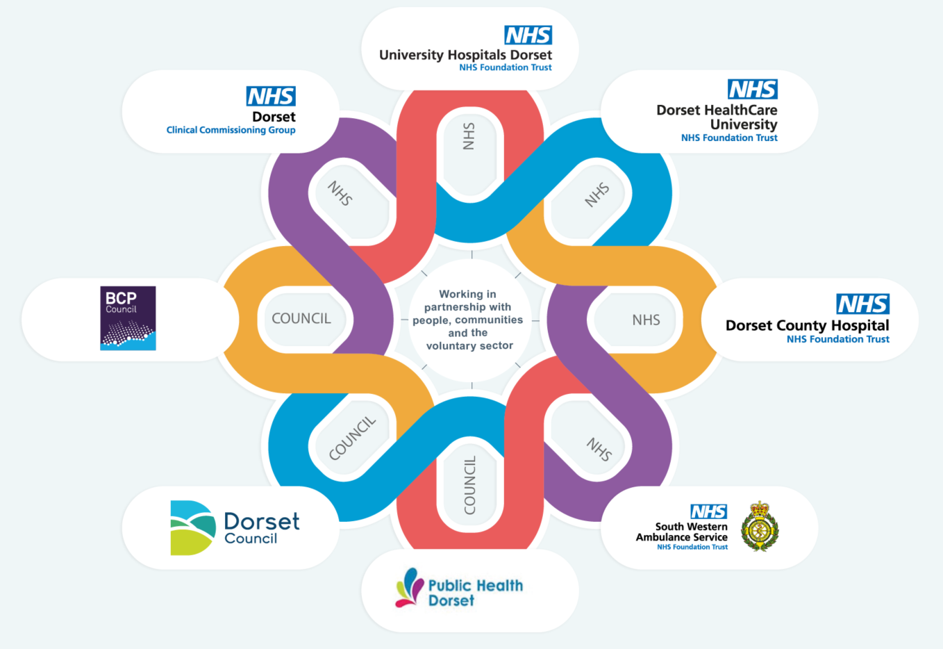







Our current system
810,000 registered practice population
422 GPs / 73 practices
2 Unitary Local Authorities
194 town and parish councils
2 Acute Hospital Trusts (over 4 sites)
1 Clinical Commissioning Group
1 Community and Mental Health Trust
18 Primary Care Networks
1 Ambulance Trust
7300 voluntary and community organisations
1 Police and Crime Commissioner
and 1 Police Authority
1 Fire Service
Notes:
In 2018, Dorset was officially recognised as one of England’s first wave of Integrated Care Systems (ICS) in which all partners (including primary care, hospitals, community care, local authorities and the
community and voluntary sector) agreed to work together to address our health, wellbeing, quality and financial challenges.
We have a successful track record and a strong commitment to collaborative working across all of our organisations.

Slide 5
The new health and care system
Our Dorset Health and Care System
Dorset Health and Care Partnership
Two partnerships based on council footprints
One collaborative with shared accountability
Public services working together with the community and voluntary sector to plan, provide and manage NHS, social care and prevention services. This includes the new Integrated Care Board (NHS Dorset)
A partnership committed to supporting people and communities to lead healthy, thriving lives and addressing inequalities so everyone has access to the right care
Working at a local level, based around our local authority areas and primary care networks to design services that meet the needs of our communities and neighbourhoods
Health organisations working together to plan, deliver and transform local services. Reducing variation across the county and improving access to services
Integrated care system
Integrated care partnership
Place based partnerships
Provider collaboratives
Notes:
The Government recognise that decisions taken closer to, and in consultation with, the communities they affect are likely to lead to better outcomes. Collaboration between partners is essential to address health inequalities and so that we can provide effective and efficient services for the people of Dorset.
ICS set out to achieve four aims: • improve outcomes in population health and healthcare • tackle inequalities in outcomes, experience and access • enhance productivity and value for money • help the NHS support broader social and economic development
This will be delivered through four main elements:, working together as an integrated system, establishing an integrated care partnership, setting up place based partnerships including neighbourhoods and having provider collaboratives in place.

Slide 6
Benefits of a joined-up system
We will:
Collectively be responsible for managing things like budgets and staffing and delivering the best care for people in Dorset
Give consistent advice and proactive support so people can stay well, particularly those who are vulnerable or at higher risk of developing serious or long-term health conditions
Join up care and treatment when needed
Improve access to services so everyone is given the right care in the right place at the right time
Work at a local level with communities on how services are delivered
Notes:
Collaborating as ICSs will help to tackle complex challenges, including:
• improving the health of children and young people
• supporting people to stay well and independent
• acting sooner to help those with preventable conditions
• supporting those with long-term conditions or mental health issues
• caring for those with multiple needs as populations age
• getting the best from collective resources so people get care as quickly as possible

Slide 7
ICS proposals
Subject to the passing of new legislation the new arrangements will consist of:
Dorset Health and Care Partnership
which will:
Be jointly set up by local authorities and NHS services
Bring together organisations and people who have an interest in health and wellbeing
Develop an ‘integrated care strategy’ to support communities to lead healthy, thriving lives
NHS Dorset Integrated Care Board (ICB)
responsible for:
Working with partners and local people to plan services that meet the needs of our communities
Establishing joint working arrangements where we can across partners
Making sure the right health services are being provided in the right place and at the right time
Notes:
The proposed ICS structure will have two core elements: An Integrated Care Partnership (ICP) and an Integrated Care Board (ICB).
It is important to note that these are still proposals and subject to full legislation being passed.
The Integrated Care Partnership will be responsible for agreeing an integrated care strategy for improving health care, social care and public health across their whole population, using the best insights from data available, built bottom-up up from local assessments of needs and assets identified at place level and focusing on reducing inequalities and addressing the consequences of the pandemic for communities.
The Integrated Care Board will continue to deliver the same functions that the existing Clinical Commissioning Group have with some additional responsibilities. There is an employment commitment for staff currently working within Dorset NHS CCG who will transition to the new organisation.

Slide 8
Dorset Health and Care Partnership
The partnership will provide a forum for NHS leaders and local authorities to come together, as equal partners, with important stakeholders from across the system and communities. The membership of the partnership will include:
Chair
BCP Council
Dorset Council
NHS Dorset
Dorset Police
Dorset and Wiltshire Fire
Dorset HealthCare
Dorset County Hospital
University Hospitals Dorset
South West Ambulance Trust
Voluntary Sector Alliance
Wessex AHSN
Higher education
Public engagement group
Digital public engagement group
Dorset LEP
Each area will have a public representative on behalf of the wider groups, communities and organisations

Slide 9
Partnership responsibilities
The partnership is a statutory function supporting integrated working across the county.
They will complement the ongoing activities of the existing Health and Wellbeing Boards
by promoting integration from place level to system level.
Responsibilities include:
addressing inequalities in health and wellbeing outcomes and making sure there is better access to health services
bringing together people and organisations involved with wider issues like employment, education, housing and crime to support healthier communities
improving the life chances and health outcomes of babies, children and young people
supporting communities to live more independent, healthier lives for longer

Slide 10
Integrated Care Board Governance
The minimum membership of NHS Dorset includes a chair, chief executive and three other member. ICBs are also free to have other members above and beyond the minimum
Chair designate – Jenni Douglas-Todd
Chairs are appointed by NHS England and approved by the Secretary of State
Chief Executive designate – Patricia Miller
Appointed by the Chair and approved by NHS England
At least three Partner Members, including:
one from local NHS Foundation Trusts
one from local providers of primary care
one from local authorities
At least two Non-Executive Directors (one to chair the Audit Committee and one to chair the Remuneration Committee)
Chief finance officer
Chief nursing officer
Chief medical officer

Slide 11
Integrated Care Board finance
Decisions about spending will be given to local Integrated Care Boards (ICB).
NHS Dorset Integrated Care Board, working with partners, will agree how money will be spent based on what local people and communities need.
This will include budgets for:
Hospitals, community and mental health services
It may also include:
Community services such as dentistry
Highly specialist services for example specific cancer therapy
Notes:
Local systems will have more control and flexibility over how NHS money is spent in line with health and care priorities set at a local level. They will also be able to commission services jointly with local authorities.
The ICB will have an agreed framework for collectively managing and distributing financial resources to address the greatest need and tackle inequalities in line with the NHS system plan, having regard to the strategies of the Integrated Care Partnership and the Health and Wellbeing Board/s.

Slide 12
Place based partnerships
Working more closely with local communities creates opportunities for health and care organisations to improve the services they provide.
We will have two partnerships – one in the BCP Council area and one in the Dorset Council area
These partnerships will:
Work together to tackle common challenges
Talk to and work directly with communities, voluntary sector and neighbourhoods
Use local community projects and organisations to deliver services where possible
Co-ordinate local action and support communities to have control over their wellbeing
Notes:
We know neighbourhood teams know their areas best so we will be setting up two partnerships where local organisations can work together to improve the wellbeing of their populations.
We will have two partnerships – one in the BCP Council area and one in the Dorset Council area. We want decisions to be made as close as possible to local communities our place based partnerships will be key in doing this.

Slide 13
Provider collaboratives
Provider collaboratives brings together organisations delivering similar services.
By bringing them together we can improve quality, use resources more effectively and deliver quality services consistently to everyone, no matter where they live in the county.
Provider collaboratives aim to:
Give people the right care, at the right time and in the right place
Improve the experience people have using our services
Share resources like staff and equipment
Improve quality and positive outcomes for people
Shared accountability for finances and contracts
Notes:
Provider collaboratives brings together all those that provide similar services. It gives us a platform to do things better and address challenges. It removes the competition between organisations and refocuses on what people and our communities need from our services.
Formalising into a collaborative means the organisations will have shared accountability for finances and contracts.

Slide 14
Involving our communities
Our Dorset approach to public engagement has a strong focus on working in partnership with people, communities and the voluntary sector.
We collectively agree that strong engagement and communications is crucially important so that we achieve the best outcomes with, and for, our communities.
To do this we are:
Co-creating a strategy for working in partnerships with people and communities – with a focus on collaboration and co-production. It starts with the person.
Setting up a countywide citizens panel to jointly listen to, and act on, the experience and aspirations of local people. This will have a focus on reaching out to diverse communities and areas of inequality.
Co-designing a voluntary, community and social enterprise sector alliance to enable the sector to have a voice and influence at all levels – whether strategic, place or neighbourhood
Notes:
We have a strong network of engagement professionals across all partners within the integrated care system including the community and voluntary sector. Lots of work has been going on across these partners over the last few years working with and engaging with a range of people, communities and stakeholders.
This ‘continuous conversation’ with our residents helps inform our services and gives us a mechanism for feeding back on communities on you said > we did.
Though the public health team and voluntary sector we now have a network of trusted voices so we can engage with communities who we don’t often hear from in a way that is useful to them and in a format that meets their needs.
At the moment we are:
Reviewing existing feedback for what people have told us about working in partnership with each other, people and communities, inequalities, communication and digital inclusion. Looking at how these views have already informed service provision and who else we need to talk to.
Continuing to gather insight and experiences of people who use care and health services, including people less often reached, especially those affected by inequalities.
Exploring how we will work in partnership with people and communities, making sure local people are represented in decision making forums.
Telling the 'Dorset Story' using real people and their stories to demonstrate improved outcomes.

Slide 15
Timelines
April - June 2021 scope and draft plans
June - Dec 2021 planning and design including governance and place- based partnerships
Oct - Mar 2021/22 ICB designate board appointments
Sept - Jul 2021/22 implementation
01 July 2022 New NHS Dorset Integrated Care Board goes live
Notes:
Subject to the legislation being passed the aim is to have the new ICS NHS body live for 01 April 2022

Slide 16
Getting in touch
Find out more about our Integrated Care System at:
ourdorset.org.uk
Got a question or query?
email us via ICS@dorsetccg.org.uk
Notes:
Subject to the legislation being passed the aim is to have the new ICS NHS body live for 01 April 2022

