Slide 1

NHS Rainbow Badge Programme- Phase II

Slide 2
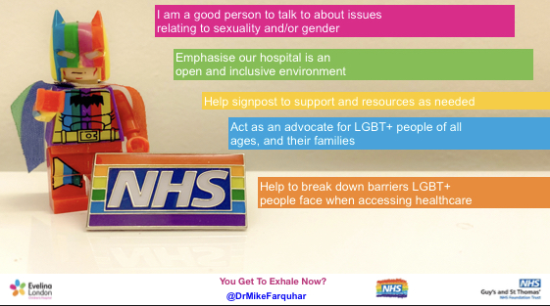
NHS Rainbow Badge Phase 1
Phase 1 of the NHS Rainbow Badge was created to combat some of the key barriers to healthcare for LGBT people, as well as the fact that almost a quarter of healthcare staff had witnessed colleagues behaving in a way that could be considered homo/bi or trans-phobic.
It had its official launch in 2018 and since then over 150 Trusts across England have launched NHS Rainbow Badges.
People had to actively sign up for a badge after reading core information and signing a pledge.

Slide 3
Phase II Pilot
NHS England commissioned a collaboration, consisting of the LGBT Foundation, Stonewall, the LGBT Consortium, the Brighton & Hove Switchboard and GLADD, to develop and deliver a Phase II Pilot.
The pilot for Phase II moved from a pledge based system towards an assessment model and allowed Trusts to demonstrate their commitment to reducing barriers to healthcare for LGBT people, whilst evidencing the good work they have already undertaken.
The criteria for the pilot was written following input from 5 separate focus groups. 2 of these groups featured professionals who gave a valuable insight into the challenges facing Trusts when trying to be more inclusive of LGBT staff and patients. 3 of the groups were for patients only and allowed for a greater understanding of the lived experiences of LGBT patients.

Slide 4
Pilot Assessment process
Policy review
Staff survey
Patient survey
Assessment questionnaire- completed through a collaborative workshop approach or self submission document

Slide 5
What was assessed?
Clinical service provision: Including Perinatal, Fertility, Oncology, Laboratory, Sexual Health & Gynaecology
Mental Health & Learning Disability service provision
Workforce inclusion
Leadership
Sexual Orientation, Gender and Trans Status monitoring
Facilities
Engagement

Slide 6
Timeline for Pilot Trusts
Policy review: 1 month to complete
Staff and Patient surveys: 4 – 6 weeks
Main assessment: 6 weeks
Assessment review period: 2 weeks

Slide 7
Outcome
The information from all aspects of the assessment process was reviewed and the Trusts received a graded award reflecting their current LGBT inclusion work. Grading was available across the following levels: Foundation, Bronze, Silver and Gold.
In addition to the award the Trusts received a comprehensive feedback report and action plan, this was designed to help Trusts achieve the next level and should facilitate meaningful change.
Where training gaps are noted the action plan may have included contacts for organisations who the Trusts can contact to provide this.

Slide 8
Findings so far
What went well?
Engagement – Trusts and Patient Voices
Relationship building
Appetite for change
Seeing the work being delivered to improve services in different areas
Opportunities to share best practice
Challenges?
Timescales
Availability of key people within Trusts to support the process
Support requirements within Trust varied hugely
Staff retention of prior training

Slide 9
Services Survey
One Trust developed a services survey which was sent to all their clinical service leads. The survey took an average of 12 minutes for completion and included seven aspects of care/environment:
• Inclusion Signifiers & Physical Care Environment
• The Virtual Care Environment
• Patient Information
• Patient Care & Record
• Patient Surveys
• Staff Training
• Specific Service Questions (Laboratory, Perinatal health, Gynaecology, Fertility, Oncology, Sexual Health)

Slide 10
What next?
With a successful pilot completed we are now looking to roll the scheme out more fully. NHS England has commissioned the provision of this for another 40 Trusts across England.
Learning from the pilot process and input from those Trusts involved has led to the revision of the assessment model slightly. Key changes include:
Increased timescales
Increased opportunities for support meetings with a member of the NHS Rainbow Badge team
Change in how we assess the work being conducted by clinical services: Policy Reviews, Staff/Patient surveys, Clinical Services survey, Assessment document
Reviewing the work done to make spaces inclusive of intersex people

Slide 11
Timeline
Month 1- Induction meeting with team, provision of all assessment materials. Discuss personalised timeline including launch of staff/patient surveys
Month 3- Policy document submission. Launch services survey.
Month 4- Policy review feedback
Month 6 – Submission for final assessment and cut off for services survey
Assessment review period: 1 month

Slide 12
Policy Review
Adoption Policy
Special or Compassionate Leave Policy
Maternity Policy
Paternity Policy
Shared Parental Leave Policy
Trans inclusion policy
Uniform/dress code policy
Discrimination, bullying and harassment policy

Slide 13
Staff/Patient surveys
Fully anonymous
No free text on patient facing survey
Acts as a cross checker

Slide 14
Services survey
Goes out to all service leads
Will be followed up by Assessor with an evidence list
Inclusion signifiers within the physical Care environment
Virtual care environment - unscored
Patient Information- leaflets/posters etc
Patient Care & Record
Sexual Orientation, gender, trans status monitoring
Staff Training
Specific Service Questions (Laboratory, Perinatal health, Gynaecology, Fertility, Oncology, Sexual Health)

Slide 15
Final Assessment
Recruitment and induction of staff
Training
Support for non-binary employees
Communications of support for LGBT+ people
Senior leadership
LGBT+ staff networks and activities undertaken
Intersectionality
Temporary staff

Slide 16
Impact
Patient experience improvements.
Community engagement facilitated.
Staff retention and satisfaction increases.
Demonstrates meeting legal requirements to reduce health inequalities.
Access to expert support, best practice guidance and case studies.

