Slide 1

Introduction to Eating Difficulties
Becca Shelton
Susan Griffiths
Emily Paintin
Please ensure your sound is turned up

Slide 2
Eating
Eating is one of the most complicated activities we do as human beings and there are multiple factors that can affect feeding. If there are problems in any one of these areas, feeding behaviour can be affected.
Developmental status.
Medical issues, and Body mechanics (oral-motor abilities)
How food tastes, smells, and feels (sensory issues)
Positive or negative experiences relating to food

Slide 3
Professionals involved in eating
Paediatrician
Dietician
Occupational Therapist
Speech & Language Therapist
  Oral motor skills
  Choking/coughing/swallowing
  Communication

Slide 4
Typical Developmental Stages
Texture:
5-6 months- thin textured baby cereals
6-7 months- thin purees
Around 8 months- thicker textured cereals and purees
8-9 month’s- hard munchables
9-9 ½ month’s- Hard meltables
10- 11 months- soft foods
12 months- mixed textures
24 months- fully refined skills
Taste:
Birth- We are born with preferences for food that our mother has eaten on pregnancy as babies can taste food through the amniotic fluid.
Birth- 6months- preference for sweet foods as breast milk is sweet.
4-6 months- easily accepts new foods
14 months- 8 years- neophobic (fear of new foods) response
Notes:
Every child will vary

Slide 5
Typical “Picky Eating”
It is completely normal for a toddler to reject foods that are new or unfamiliar to them
Our sensory system is designed to protect us from potentially harmful foods by rejecting strong smells, tastes or foods that are unfamiliar
Children are likely to also reject new foods if they are:
- distracted by toys, tv etc
- upset or tired
- feeling unwell
- have constipation
- not hungry because they have been snacking
Notes:
Common terminology is picky eater but we try to avoid this term as much as possible especially around the child as it is sending a negative message about food.

Slide 6
Typical limited diet
Breakfast: 1 Weetabix with milk
Mid Morning: 2 rice cakes
Lunch: jam sandwich, 2 slices bread, packet crisps
Mid afternoon: crumpet with margarine and jam
Evening meal: 2 chicken nuggets, 1 smiley face
Fluids:250ml full cream milk, 400ml squash

Slide 7
Recommended nutritional intake for pre school children (school aged children will require slightly more)
Provides:
1048kcal
27g protein
450mg calcium
Requires:
1170kcal
11g
350mg

Slide 8
Provides
6.9mg iron
39mg vitamin C
7 micrograms vitamin D
Requires
7.5mg iron
30mg vitamin C
1 micro gram Vitamin D

Slide 9
When picky eating is a problem?
When your child is losing weight
When your child is showing signs of poor health relating to eating
If your child is eating very few types of food
If mealtime behaviours are causing stress and anxiety

Slide 10
Motor Skills
Oral motor skills to close mouth around a cup
Oral motor skills to chew and swallow food
Eating and Drinking
Postural control to be able to sit upright on a chair at the table
Coordination and body awareness to find mouth with food/cup
Strength to bring food to mouth in hand or on spoon/fork
Fine motor skills to use cutlery or hands to eat

Slide 11
Behaviour and Anxiety
Picky eating may have a behavioural element but this is unlikely to be sole reason for the difficulties
Children may have learnt behaviours and attitudes to food from family members
Some difficulties start with a sensory basis but become learnt behaviours over time
Anxiety produces a fear response including increased adrenaline. This causes blood to rush away from your digestive system reducing your appetite
The normal reaction is to avoid an anxiety provoking situation which will effectively reinforce not eating. If you stay in an anxiety provoking situation long enough, your anxiety plateaus and then slowly decreases.
Notes:
If a child is refusing to eat this is likely to cause a great amount of stress around meal times however this can reinforce that eating is a unpleasant experience and make the child even less likely to eat.

Slide 12
Common Sensory Eating Issues

Slide 13
Over-responsive to visual input
  Avoids eye contact
  May attempt to scatter food off the table because visually overwhelmed
  May look away from food or close eyes
  Moves chair back from table
  Repeated eye blinking or eye watering
  Squinting
  Vomiting

Slide 14
Over-responsiveness to Smell
  Covering the nose with hand/shirt
  Eye watering
  Turns head away
  Makes a funny face
  Coughing/gagging to smells

Slide 15
Over-responsiveness to tactile input
  Lip splays
  Grimacing
  Frequent hand wiping
  Finger splaying

Slide 16
Over-responsiveness to taste
  Gagging
  Vomiting to tastes
  Grimacing/lip splays
  Shudders

Slide 17
Over-responsiveness to auditory input
  Repeated eye blinking
  Startling to noises
  Cover ears during the meal

Slide 18
Under-responsiveness – Low registration
Does not react to large noxious smells
Cannot locate or loses food in mouth
Pockets food in mouth
Staring into space
Humming, rocking, self-stimulation
Swallows food whole or barely chewed
May not display facial expressions
Notes:
Be aware some children pockets food in mouth because they don’t like it

Slide 19
Under-responsiveness - Seeker
Prefers big and/or complex flavours/tastes
Appear to have decreased pain responses
Constantly in motion
Crashes, climbs everything – may appear aggressive
Grinds teeth
Seeks spinning
Overstuff food into mouth
Intense examination of details

Slide 20
Sensory Discrimination
The discrimination requirements of feeding changes over time as development progresses, and as the type of food offered is changed
Child with discrimination issues has a very black & white view towards food. Food is either disgusting or delicious – nothing in between.

Slide 21
Steps to Eating
It is a 25 to 32 step process
Begins with Sensory Integration
Main steps:
  Tolerate
  Interacts with
  Smells
  Touch
  Taste
  Eating

Slide 22
Steps to Eating
Steps |  | Description
1 | Tolerates | To be able to tolerate the physical presence/sight of the food (i.e. being in the same room as the food or at the same table as the food)
2 | Interacts with | To be able to interact with the food WITHOUT touching the food to their skin (i.e. uses a napkin or other food to touch the target food)
3 | Smells | To be able to tolerate the smell of the food
4 | Touch | To be able to touch the food to his/her skin (i.e. tolerates the food touching a body part, including fingers, hands, face – the closer the physical proximity to the mouth, the more threatening)
5 | Taste | To be able to taste the food (i.e. an action which results in the child getting a taste of the food and processing the taste of that food)
6 | Eating | To be able to chew and swallow the food, or at least some part of the food.

Slide 23
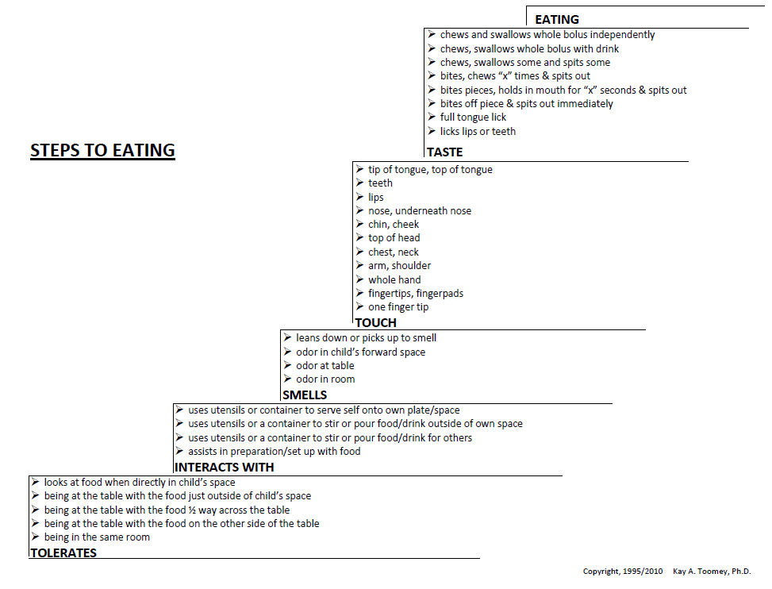

Slide 24
Strategies to try at home…

Slide 25
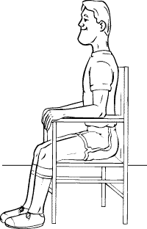
Seating
The correct seating position=
1. Able to easily reach table
2. Able to place feet firmly on floor with knees and hips at roughly 90 degrees
3. Central in the chair with body symmetrical if possible
Notes:
If needed place a step or books strapped together under feet
Child must be able to sit upright without leaning, swaying or dangling his or her feet.
This physical stability promotes good feeding behaviors and reduces distracting behaviors by allowing him or her to feel “grounded” and safe.

Slide 26
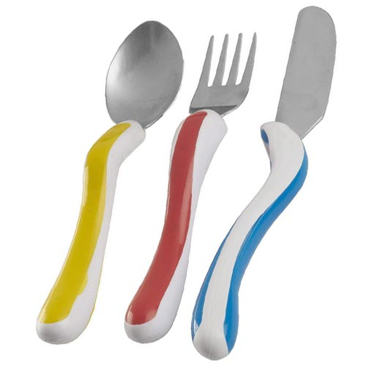
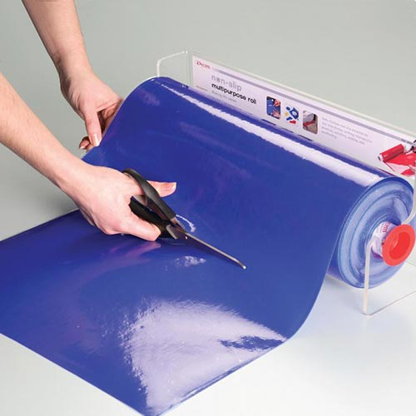
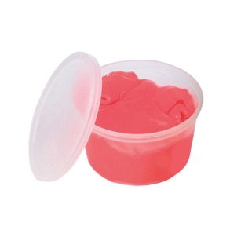
Motor Skills
Equipment such as Caring cutlery or non slip mats can be used
Practice makes perfect! Practising away from meal times is best for example with putty/play dough or snacks
Practise skills such as star jumps or opposite hand clapping if your child is finding it difficult to use their knife and fork together.

Slide 27
Managing Behaviour and Anxiety
Try and identify what emotions your child is really feeling rather than focus on the behaviour she/he is displaying
Eating is not a pleasant experience for many children with feeding aversion therefore try to change this and make eating fun
Use as much positive language as possible and model food exploration yourself
Reinforce any interaction with the food with praise
Boundaries help a child understand what is acceptable behaviour and what is not, this will also help to develop trust.

Slide 28
Adults’ Interaction
Constructive | Non-constructive
Encouraging the child verbally and non-verbally Giving the child space and time to eat Smiling Modelling eating Positive facial expression Consistency between carers | Constantly urging to eat. Trying to get the child to eat more and quicker, offer opinions on the food, e.g. “Try it”, “Come on”, “Have some more”, “Bite it”, “Mmm, it’s lovely”, etc. Reminding the child that if he doesn’t eat he won’t grow to be big and strong Carer standing while feeding the child – always looking down on the child Talking incessantly – topic doesn’t matter Not talking at all – giving no feedback to the child Goals are too big – e.g. telling the child to eat two bowls of pasta, 3 pieces of bread, etc. Using lots of questions e.g. “will you eat this for your mum, please?” Pretending to force feed Keep changing the goals – every time the child does what is asked, you make a new goal Make threats i.e. if you don’t eat this you can’t have pudding or if you don’t eat this you can’t play outside Pleading with the child Getting frustrated with the child

Slide 29
Teaching your child
Every meal/snack/cooking activity is an opportunity for you to teach your child about food
Give the food a name and describe what it looks like (colour, shape, size, texture)
Teach the physics of food – explore the food with your hands and eyes. You need to support your child to understand as much about the food as possible BEFORE it gets in the child’s mouth
If it too difficult for your child to talk about their food, then talk about your own food.

Slide 30
Food Chaining
Make sure each food presented is connected to the previous food by at least one sensory property
Easiest = Size Start here
Shape
Colour
Texture
Taste
Hardest = Temperature Last

Slide 31
Sensory solutions
If your child is struggling with a food:
  1st step: reassure child
  2nd step: label the sensory issue (it is too wet, does it smell too strong ; is it squishy, etc)
  3rd step: Give a better solution - show and tell them how to alternatively manage that food
Examples:
  You can wave the smell away
  You can wipe off your tongue
  You can dry it off
  We can add a better taste
  You can hold it with this napkin or with your fork
  You can use your spoon
  We can change the colour or we can cover it up
  We can cut it into smaller pieces

Slide 32
Eating schedule/routine
Have your child eat at the same place and follow the same mealtime schedule and routine.
Keeping the same time, place and routine helps your child to know what will happen during mealtimes and what you want him/her to do during meals.
Avoid all day eating – do not allow snacking all day or have food/drink available all day. This decreases appetite, willingness to try new food, and the number of total calories taken for the day. Set aside 5 or 6 scheduled meals/snacks a day and limit how much your child eats at other times.
Limit mealtime. Even picky eaters do most of their eating in the first 30 minutes. Limit mealtimes and snacks to 15-30 minutes. At end of the mealtime, remove all food and allow your child to move on to other activities.

Slide 33
Further Strategies
Present new foods one at a time
  Model sequence of steps to accepting food (begins visual tolerance, gives choice to child where to enter steps to eating hierarchy)
Ensure a drink is easily accessible to your child
Foods need to be matched to the sensory tolerance of the child
One preferred food at every meal/snack/cooking activity
Have several foods on the table for exposure

Slide 34
Where possible, families should cook together and eat together.
Child is NOT the focus of the meal – food is.
Make food fun
Encourage child to be involved in all aspects of the meal and prep as developmentally appropriate
Playing with the food is reinforcing in itself, and touching the food desensitises child
Allow child to taste and spit out (only if they are at this stage)

Slide 35
Categories of food play progression
Stage | Explanation
Pretend food play | Seen as a foundation upon which more advanced skills develop, that is dry and finally wet food play
Dry food play | Divided into stages representing developmental progress. A child progresses from coarse to increasingly fine dry textures.
Wet food play | Divided into stages representing developmental progress. The development relates to the type of tactile feedback the child gets from the food. Wet firm consistencies Wet tacky consistencies Wet semi-solid consistencies Wet liquid consistencies Wet mixed textures

Slide 36
Food play progression
Pretend food play level is usually completed relatively easily with longer periods needed for dry and wet food play
Many children find it difficult to progress from dry to wet food play: this transition can be facilitated by:
  Creating a barrier between the child’s hand and the wet food i.e. manipulate food held within a zip-lock bag; wear surgical gloves for food painting and gradually reduce the barrier by cutting some of the fingers from the gloves; or wear a finger toothbrush to touch the food, etc.

Slide 37
Wet food hierarchy
Consistency | Example | Suggested activity
Wet firm | Dough | Make pizza dough, bread or scones
Wet tacky | Cooked rice pasta | Make fruit crumble
Wet semi-solid | Set custard Greek yoghurt Jelly Mousse | Make Angel Delight, jelly or mousse
Liquids | Pouring custard Pouring cream Yoghurts | Make pancake batter or juices
Mixed textures | Minestrone soup Pasta and sauce Rice pudding Pizza with a topping | Make pizza toppings, krispie cake, or fruit salad

Slide 38
Feely bag Activity
A feely bag activity to explore food with the senses of touch and smell
Smell:
  Sour: concentrated lemon juice
  Spicy: tomato paste/ketchup
  Sweet: jelly toys
  Bland: plain biscuits, fromage frais
  Fishy: Worchestershire sauce
Textures:
  Hard: biscuit
  Soft: marshmallow
  Smooth: apple
  Sticky: dates
  Greasy: puffed crisps
  Wet: yoghurt
  Furry: peach
  Textured: rice, hundreds and thousands

Slide 39
Pretend tea party Activity
A pretend teddy and dolly tea party using toys but with access to real food
This will offer the child the opportunity to experience food without the threat of having to eat it, and also give them the experience of playing out the rituals of mealtime through pretend play as a ‘prelude to reality’.
For the child for whom it is developmentally appropriate to engage in symbolic play, model feeding dolly and teddy while labelling and expanding on the activity.
Vocabulary should be food-centred, focusing on textures, smells, etc.

Slide 40
Food Shopping activity
A visit to the local supermarket to purchase food with a view to cooking and preparing it later. Extra time should be built into the timetable for such an external activity. An outing to a supermarket is a very normal, typical activity for the majority of children, but perhaps not for the child with food aversion. The visit itself also exposes the child to food and drink outside of the context of actually having to eat it.
Example of food to prepare and cook with the child: packet dessert mixes that only need to be whisked with milk

Slide 41
Let’s cook activity
Prepare and cook the food purchased from the supermarket. This activity exposes the child to food, physically touching food, and food preparation, in a non-threatening way. It also increases control over the food in question as the child prepares the food himself or is an active participant in the process.
Prepare for cooking by setting the table and fetching necessary utensils and crockery.
Take turns in opening the food packets, spilling out the contents into a bowl, mixing/stirring, etc.
Notes:
Remember where your child’s sensory tolerance is.

Slide 42
Food play (messy play)
Aims of food play:
  To desensitise the child to food smells and textures
  To help prepare the child for eating
  To assist in developing a positive attitude to food

Slide 43
Food Play Example

Slide 44
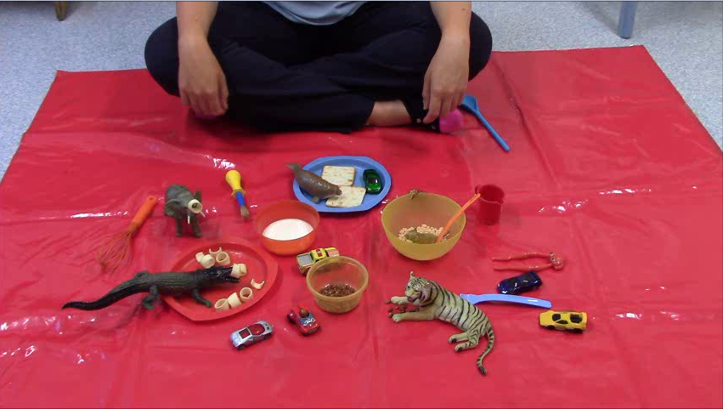
Please click on the link below to watch an example of a food fun session:
https://www.youtube.com/watch?v=OVqrmwBLNWc
Remember: make food fun as playful as possible to engage your child and ensure they have a positive experience! This could involve making sound effects and positive noises (for example “wheee” “splash” “mmmm” “yay” “yummy”) If the child gets distressed you have gone too far and need to go back a stage on the steps to eating hierarchy.

Slide 45
Food play example continued…

Slide 46
Thank You For Listening

Slide 47
Resources and Useful Links
Books:
Food Refusal and Avoidant eating in children including those with Autism Spectrum Conditions Gillian Harris and Elizabeth Shea
The Out-of-Sync Child: Recognising and Coping with Sensory Processing Disorder’ by Carol Stock Kranowitz
‘Living Sensationally: Understanding your Senses’ by Winnie Dunn
The fun with Food Program edited by Arlene McCurtin
Websites:
https://spduniversity.spdstar.org.diweb/start introductory online course covering contributing factors and strategies to help picky eaters.
www.sensoryintegration.org.uk- provides information on sensory integration and courses for parents
www.spdstar.org- Star institute for sensory processing difficulties

