Slide 1
Routine Blood Borne Viruses (BBVs) Testing in ED
Gary Cumberbatch and Imran Ghafoor
Consultants in the Emergency Department at UHD
January 2025

Slide 2

Rollout Details
Going Live in Poole and Bournemouth Emergency Department on 5th December 2024
Who?
ALL patients >16 years
When?
Anyone who has a blood test for any reason?
Exception
UNLESS they object!
Additional Guidance
Patient who lack capacity should be tested

Slide 3
Reasons for Routine BBV Testing
Early Detection
Public Health
Patient Care
Identifying infections before symptoms appear
Reducing transmission rates in the community
Improving long-term health outcomes

Slide 4
Infographic on BBV Statistics
HIV Statistics
Hepatitis B Statistics
Hepatitis C Statistics
106,890 people living with HIV in the UK
180,000 people chronically infected with hepatitis B in the UK
143,000 people chronically infected with hepatitis C in the UK
650, 000 people died in one year from HIV-related causes (WHO 2021)
290,000 deaths from HCV-related causes (WHO 2019)

Slide 5
Insights from WHO
Global HIV Statistics (WHO, 2022)
Global Hepatitis Statistics (WHO, 2022)
38.4 million people living with HIV
354 million people living with hepatitis B or C
1.5 million new HIV infections
3 million new hepatitis B and C infections
650,000 AIDS-related deaths
1.1 million deaths from hepatitis B and C

Slide 6
WHO Guidelines on BBV Testing
Guideline
Testing Frequency
Target Population
Testing Approach
Recommendation
Regular intervals based on risk factors
All adults in high-prevalence areas
Opt-out strategy in healthcare settings

Slide 7



Impact of Routine BBV Testing
Implementation
Introduction of routine testing in emergency departments
Short-term Results
Increased detection rates and early interventions
Long-term Outcomes
Reduced transmission rates and improved public health

Slide 8
Towards ZERO
Government Plans
End new HIV transmissions by 2030
Key Element
Opt-out testing in Emergency Departments
Your Role
WITH YOUR HELP, WE CAN REALLY MAKE A REAL DIFFERENCE

Slide 9
HIV Commission Report
2020 Report
Key Intervention
Implementation
The HIV Commission report stated a crucial intervention
Widespread HIV testing is the single most important action
Made routine across the NHS and delivered as opt-out, not opt-in, provision

Slide 10
NICE Guidance Since 2008
Recommendation
Target Areas
Duration
Opt-out HIV testing in healthcare settings, including emergency departments
Areas of high and very high HIV prevalence
Recommended in national (NICE) guidelines since 2008

Slide 11

UK Government Support For The Project
£20M
Government Commitment
Funding over 3 years to expand opt-out HIV testing in EDs
3
Years of Funding
Duration of the government's financial support
On World AIDS Day 2021, Matt Hancock committed £20 million over 3 years to expand opt-out HIV testing in EDs in very high-diagnosed HIV prevalence areas.
BOURNEMOUTH, POOLE and CHRISTCHURCH have a HIGH endemic level of HIV.

Slide 12
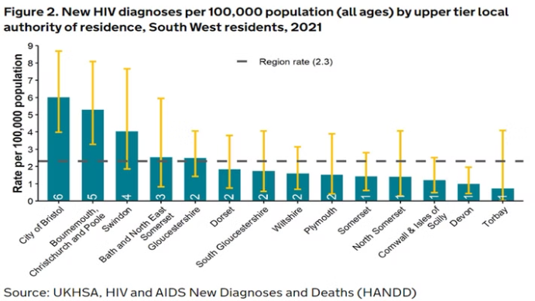

Slide 13
Other Blood Borne Viruses
To support an 'every contact counts' approach, the project was expanded to include testing for hepatitis B (HBV) and hepatitis C (HCV) in partnership with NHS England's Hepatitis C Elimination team.

Slide 14
BBV Routine ED Testing Sites Launched 2022
The ED Blood Borne Virus (BBV) opt-out testing project launched in April 2022 and includes 34 EDs:
28 in London
4 in Manchester
1 in Brighton
1 in Blackpool

Slide 15
New Diagnoses Since The Launch
New BBV Diagnoses
4,440 people
Previously Diagnosed Patients Re-engaged
1,098 people
4,440 people have been newly diagnosed with a BBV, with the majority of those newly identified living with Hep B
1,098 previously diagnosed patients who had stopped engaging with health care services have been brought back into the system and are now accessing healthcare services

Slide 16




National Guidance On How To Do The Testing
Simple Guide
Existing Examples
NHSE worked with BHIVA, BIA, and RCEM to create a quick guide on opt-out BBV testing for Emergency Departments.
Opt-out testing is already used in other areas of healthcare, such as:
Organ donation
Antenatal screening
Sexual health clinics
Working for the NHS

Slide 17
History of Opt-Out Testing
1
2009: HIV Opt-Out Testing Pilot
HIV opt-out testing in Emergency Departments has been successfully piloted in the UK as early as 2009.
2
2014: Combination Testing Pilot
Combination HIV, HBV and HCV opt-out testing in Emergency Departments has been successfully piloted in UK as early as 2014.
3
Continued Success
These early pilots have paved the way for wider implementation of opt-out testing strategies in Emergency Departments across the UK.

Slide 18
Advantages of Opt-Out Testing
Increase uptake of the tests
Reduces patient and staff anxiety
Increase earlier diagnosis and treatment
Reduces transmission of these diseases
Reduces health inequalities (less uptake by certain groups)
Routine testing normalises the process and reduces stigma
Cost effective

Slide 20



About Their Results?
Negative Results
Positive Results
Questions?
Patients will NOT be told if their test is NEGATIVE
If your test is positive, you will be contacted within 4 weeks.
If you have any questions, please phone the number on the poster.
No news is GOOD news!

Slide 21
Help us to get as many patients tested as possible to ELIMINATE these diseases!

