Slide 1
What is Neurodiversity and Why it Matters?
Presented by Donna Stevenson (she/her)
donna@neurobox.co.uk

Slide 2
Neurodiversity 101

Slide 3
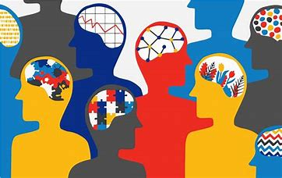
Neurodiversity? A Growing Family of Differences…
Dyslexia
ADHD
Autism
Developmental Co-ordination Disorder/ Dyspraxia
Dyscalculia
Obsessive Compulsive Disorder
Tourette Syndrome
Synaesthesia
Dysgraphia
Developmental Language Disorder

Slide 4
The Statistics…
Around 15% of the UK population is Neurodivergent.
ADHD affects 3-4% of adults
Dyslexia is the highest incidence disability, around 10% of the population has dyslexia.
Over 700’000 people are on the autism spectrum
Only 10% of HR Professionals state neurodiversity is included in their people management practices Source: Neurodiversity at Work Report, CIPD
73% of respondents hide their dyslexia from employer Source: Connecting the Dots Report, Made By Dyslexia
Employment tribunals linked to conditions such as autism, ADHD, dyslexia and dyspraxia up by a third Source: Employment law firm, Fox
By 2030, 57% of UK workforce will be Gen Y and Gen Z, it is estimated that at least 50% of Gen Z identify as Neurodivergent.
Notes:
Gen z – 1997-2012 .Gen Y 1981 – 1996. Gen X 1965 – 1980) Recent statistics on neurodiversity in the UK indicate that approximately 15% of the population is neurodivergent[1]. This includes conditions such as autism, ADHD, dyslexia, and dyspraxia. Specifically, over 700,000 people are on the autism spectrum, ADHD affects around 3-4% of adults, and about 10% of the population has dyslexia[1].
Is there anything specific you would like to know more about regarding neurodiversity?
References
[1] Neurodiversity Statistics and Research - Cognassist

Slide 5
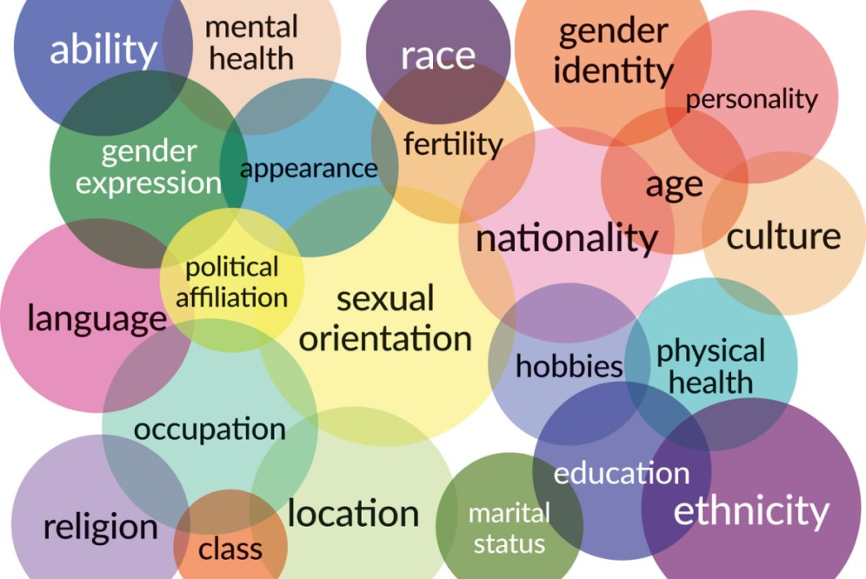
Neurodiversity and Intersectionality

Slide 6

The Lived Experience
‘If someone were to ask me the key to getting the best out of me, I would say LISTEN to me, I have lost track of the times over the years I have had managers tell me about who I am rather than ask me, it’s so arrogant and patronising. Sure there is a dialogue that needs to happen and I’m happy to listen, but please don’t pigeon-hole me before you have gotten to know me just because I am neurodivergent…’
Robert

Slide 7

Potential Neurodivergent Talents…
Determination – keep on keeping on!
Truth Teller
Disruptor!
Skilled in Atypical problem solving – unusual connections can be made due to brain patterns
Creative
Good procrastinators – incubating the best solutions
Exceptional in the right niche
Confident, good social skills
Empathic – good with people
Effective use of coping strategies

Slide 8

Potential Neurodivergent Challenges…
Organisational challenges
Short Term and Working Memory
Auditory Processing
Visual Processing
Remaining focused and concentration
Communication
Low Self-esteem
Masking and Imposter Syndrome
Rejection Sensitive Dysphoria

Slide 9
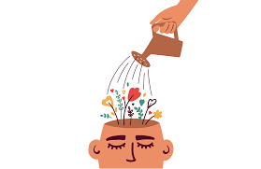
Don’t Forget… Neurodiversity and Wellbeing
Masking and hiding neurodivergent differences
Rejection Sensitive Dysphoria
Perfectionism
Presenteeism
Anxiety and Stress
Imposter Syndrome
Bullying and Ridicule

Slide 10
Setting the Scene…Why Understanding Neurodiversity Matters?
Allow everyone to be their authentic selves
Team members with lived experience of disability offer fresh perspectives...
Maintain an inclusive workforce that reflects the range of your Members
People leaders become more successful at maximising team member talent
Easier to attract and retain team members, more aligned with Gen Y and Gen Z expectations
Increase productivity
Reduce team member turnover
Legal obligation

Slide 11
Our Use of Language

Slide 12

Words Matter…
Difference not Difficulty
Difference or Condition?
Diagnosed with………. Or Identified as…………
Avoid medical language: Symptoms of….. Syndrome, Suffering with….
Dyslexic or has dyslexia?
Autism? No longer using Asperger syndrome nor Autistic Spectrum Disorder (ASD)
The ‘Disorder’ debate – ADHD, OCD
Offering ‘help’ to colleagues: Respect and Understanding…
The Lived experience and authentic voices. Masking neurodiversity.
When in doubt, take your lead from the individual and mirror the language they are most comfortable with as much as appropriate.

Slide 13

Disclosure – Starting the Conversation
Personal Choice
Can share at any time…
Do not ask ‘Do you have Dyslexia…’
Lots of information available
Training
Culture of Positivity
Allies/ Champions
Address challenges within appraisal

Slide 14

Identification
Conversation – self identification
Checklist
Screening Tool
Diagnostic Assessment
Workplace Needs Assessment
Remember…
Employers are not obliged to provide a Diagnostic Assessment, however there must be a response to an individual raising dyslexia as a concern – what that response is, is dependent on the employer, but it should be in line with the Equality Act (2010)

Slide 15
The Lived Experience…
‘I never realised that I changed who I was to fit in at work, I guess it’s called ‘Masking’ and it was exhausting for me not just emotionally, but I actually used to feel physically tired by the end of the day too. Since my identification and the journey that has followed I am actually the real me at work now, it’s been tough finally getting to this place, but so worth it…’
Charlee

Slide 16
Championing Neurodivergent Talent

Slide 17

Top Tips for Embracing Neurodivergent Talent
1. Listen and work with me – value the lived experience
2. Clear and concise communications and structured ways of working
3. Understand one size will not fit all
4. Time
5. Do your homework… Get educated
6. Keep it real and be pragmatic
7. Regular check-ins
8. Create a ND Playbook
9. Agility in ways of working,
10.Create a sense of Community – Allyship, peer support group, Neurodiversity Network
11. Wellbeing is at our heart – we value psychological safety at work
12. Technology can help!

Slide 18

Developing a Playbook…
What’s a Good Fit for Different Ways of Working?
Micro-Changes
Top Tips on Shared Intranet
Environmental Impacts? Noise, Lighting etc
Providing Extra Time?
Mini-Breaks?
Assistive Technology, including AI (e.g. CoPilot, Chat GPT)
Strategy Coaching: Support with multi-tasking, task overload
Buddy System
What works for me? Lunch and Learn Hack Sessions! (Colleagues’ Lived Experiences)

Slide 19
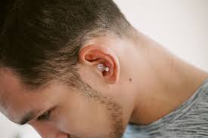
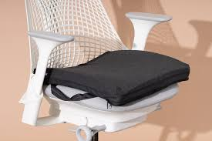

Neuro-Inclusive Environment
Noise levels
Lighting
Colour, finding your way around, directions
Smells
Hot Desking issues
Double screens
Mini Breaks
Noise cancelling headphones/ sensory ear plugs
Seating – position cushion

Slide 20



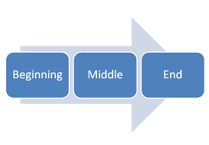
My Top 5!
1. Time
2. The ability to record
3. Speech to Text / Text to Speech Software
4. ‘Structure’ and ‘Bitesize chunks’
5. Attitude – work with me!

Slide 21

Belonging at Work with Neurodiversity

Slide 22

What is Belonging?
An employee's sense that their uniqueness is accepted and even treasured by their organisation and colleagues.
You feel comfortable, to share your opinions, to feel truly cared about and accepted, and not afraid to be yourself.

Slide 23
5 Pillars of Belonging
Welcomed
Known
Included
Supported
Connected

Slide 24

The Messages Shared by the 5 Pillars of Belonging…
We are listening and you have a voice
You are an important part of our team
We value you and your work
We care
We acknowledge your experiences
We are Inclusive
We ‘get it!’

Slide 25

Is the Opposite of Belonging Fitting in?!
“Fitting in is about assessing a situation and becoming who you need to be to be accepted. Belonging, on the other hand, doesn't require us to change who we are; it requires us to be who we are.”
Brene Brown 2023

Slide 26

The Benefits of Encouraging a Sense of Belonging…
Reduces stress and anxiety
Encourages self-advocacy
You can’t be what you can’t see…
Avoids ‘Inclusion – Wash’! Makes practice real and honest
Clear pathways through
Psychological Safety and secure environment
Raises awareness
Challenges unconscious bias
Wisdom and lived experiences which resonate with colleagues
Notes:
Inclusion-Wash - would be great to go into this in more detail and what this can look like.

Slide 27
Key Takeaways
Listen to neurodivergent team members and work to individual’s areas of strength as well as challenge
Explore a neurodivergent playbook, what accommodations are possible in the various ways we work, don’t forget to include the different categories of support e.g. Working Practices, Environment etc.
Don’t forget in the UK self-identification is sufficient for adjustments to be offered.
Adjustments are expected to be ‘reasonable’ and there are instances where it may not be possible to provide the support a team member may be expecting, but can we find ‘work-arounds’?
Culture is vital in getting it right for neurodivergent team members, explore ways we can do that within our teams.
The best approach to working in neuroinclusive ways is to be pragmatic and have lots
of strategies and ideas to work through with a colleague until we find a good fit.

Slide 28
Thank You & Questions
donna@neurobox.co.uk

