Slide 1
A Deep Dive into Autism
Donna Stevenson (she/ her)
Expert Training and Development Lead
donna@neurobox.co.uk

Slide 2
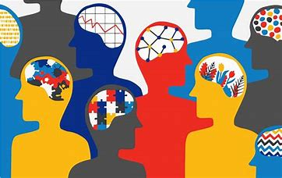
Neurodiversity? A Growing Family of Differences…
Dyslexia
ADHD
Autism
DCD/ Dyspraxia
Dyscalculia
OCD
Tourette Syndrome
Synaesthesia
Dysgraphia
Developmental Language Disorder

Slide 3


Autism in the News – How does this make us Feel?

Slide 4
Autism and the Statistics…
Estimates ranging from approximately 30% to over 85% of autistic adults being unemployed,
Autistic graduates are twice as likely to be unemployed after 15 months.
Around 21% of children with ADHD have Autism
3:1 ratio of diagnosed males to females, although some research indicates the true ratio may be closer to 2:1
70–80% of autistic children and adults experience or have experienced mental health problems in their lifetime¹

Slide 5
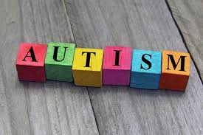
Autism – an overview
Autism Strengths
Process person
Analytical Thinking Skills
Detail Person
Thought Leader
Truth Teller
What you see is what you get
Approximately 700,000 adults and children living with Autism in the UK, around 1 in 100…
Sensitive to Sensory Overload
Social skills and Relationship challenges
Literal language interpretation
Struggles with the unexpected
Lack of Imagination

Slide 6
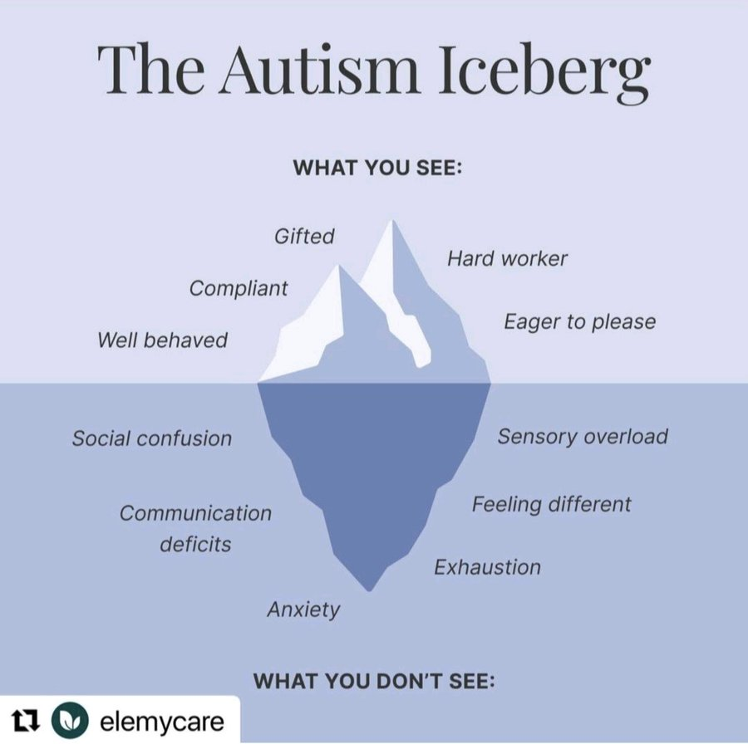

Slide 7

The Lived Experience…
‘I am a detail person, I love processes and so I do think this comes from my Autism, however I am also emotional with a strong sense of empathy too, to me this is not a contradiction about being Autistic! I think some people think we have no emotional sensitivity – not true!’
Steph

Slide 8
The Lived Experience…
‘The Greg Wallace stuff hitting the headlines about using his Autism as an excuse for his abusive behaviour is disgusting, it has damaged our community so much! As a guy with Autism, I really think people are nervous around me, thinking I am some sort of predator or weirdo, on top of everything else we live with, this is the last thing we need! ’
Raj

Slide 9
New Understanding: AuDHD… (Sourced from Autistica)
ADHD and autism frequently co-occur. Many people with one of the two diagnoses show elevated traits of both ADHD and autism.
Common experiences for ADHD and autism include sensory differences, intense focus on specific interests, rejection sensitivity, executive dysfunction, sleep issues and emotional dysregulation.
Someone with ADHD is more likely to seek out novelty and make more impulsive decisions, whereas an autistic person is more likely to crave routine and structure.
If someone is autistic and has ADHD, known as AuDHD, they may experience an internal struggle between their competing autistic and ADHD traits and a heightened experience of shared traits.

Slide 10

Autism and Mental Health Challenges
Isolation
Misunderstood and feeling like an ‘other’
Fear
Imposter Syndrome
Not sure of the way ahead
Feel invisible and under-valued
Masking

Slide 11
Part 2
The Lived Experiences of Autism

Slide 12
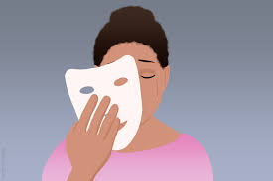
Masking – Often the Lived Experience of Autism
Supressing stimming behaviours
Enforced eye contact
Changing voice tone, verbal expression
Adhering to social pressures ‘laughing at jokes’
When an autistic person is masking, non-autistic people will still rate them more harshly than non-autistic peers if they don't know they are autistic. This unconscious bias is evident throughout society for anyone deemed to behave or think atypically by neurotypical standards.
Masking may involve suppressing certain behaviours we find soothing but that others think are ‘weird’, such as stimming or intense interests. It can also mean mimicking the behaviour of those around us, such as copying non-verbal behaviours, and developing complex social scripts to get by in social situations. With this comes a great need to be like others, and to avoid the prejudice and judgement that comes with being ‘different’.
Masking can be exhausting, but also possibly the best protection sometimes??

Slide 13
The Lived Experience…
‘I never realised that I changed who I was to fit in at work, I guess it’s called ‘Masking’ and it was exhausting for me not just emotionally, but I actually used to feel physically tired by the end of the day too. Since my identification and the journey that has followed I am actually the real me at work now, it’s been tough finally getting to this place, but so worth it…’
Charlee

Slide 14
Emotional Dysregulation and Meltdowns
Emotional regulation is the ability to cope with situations that cause emotions like stress, anxiety or frustration. Sometimes, people with autism have a harder time regulating their emotions. They may rely on unique self-soothing strategies to deal with intense emotions, and either seek out or avoid sensory stimuli like bright lights, loud sounds and intense smells.
Social challenges, sensory sensitivities, and difficulty with change all may increase frustration and stress levels,
Trying to fit into a society that is not attuned to autism
People with autism may have trouble recognizing their own emotions, or they may feel emotions more intensely
Types of Emotional Dysregulation:
Hyperarousal – “fight/flight” response, is often characterized by hypervigilance, feelings of anxiety and/or panic, and racing thoughts
Hypoarousal – shut down and feel depressed or numb. Rather than the nervous system being overly stimulated by the stress response, it is understimulated

Slide 15
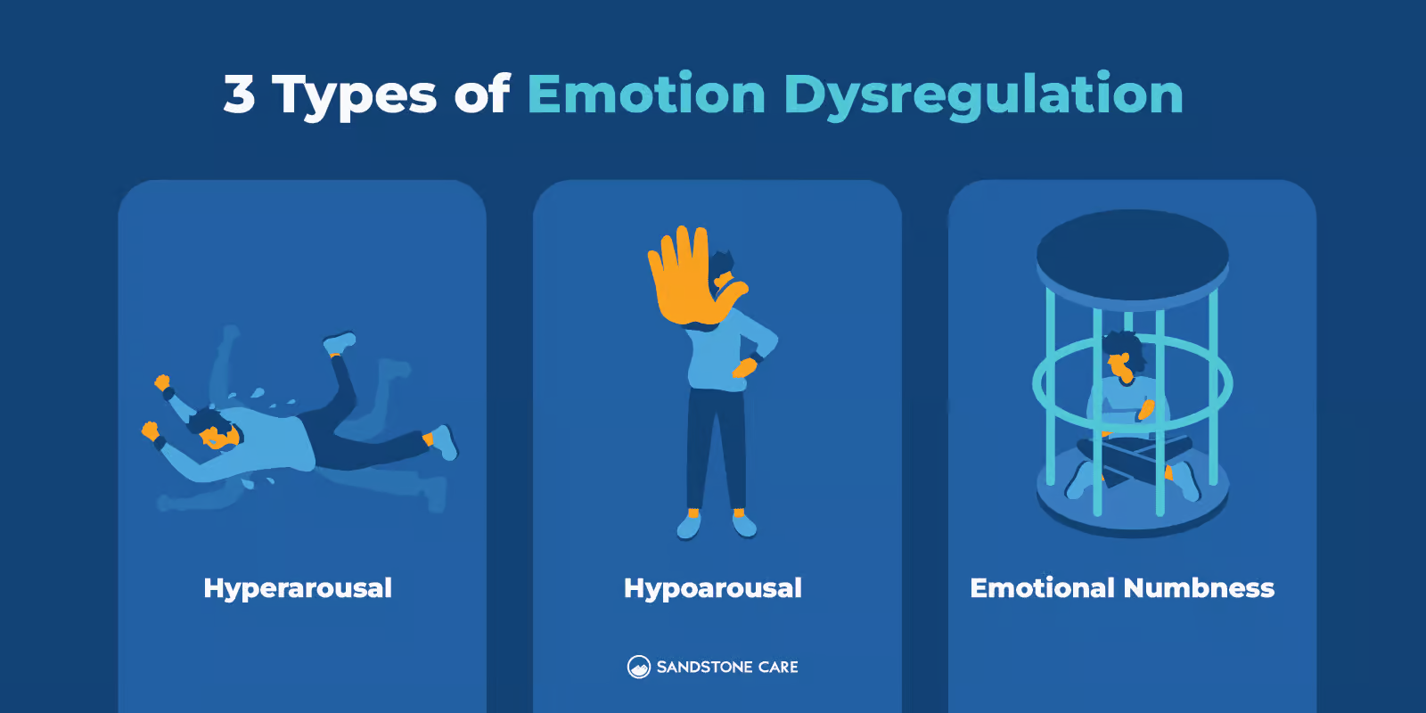

Slide 16
The Lived Experience…
‘I work in the care industry and have to deal with very upset families worried about loved ones and then trying to provide them with the support they need on a tight budget, with lots of cutbacks… A few times recently I have really lost my temper when I’ve hung up the phone, some of my colleagues have said to my manager that they are scared of me! This is the last thing I need… ’
Nico

Slide 17

How might Emotional Dysregulation Manifest?
Abrupt changes in mood
Crying spells
Emotional outbursts
Persistent interpersonal conflict
Aggression or violent outbursts
Self-harm
Poor tolerance for frustration
Withdrawn and silent
Appear distant and disengaged ‘Checked out’

Slide 18
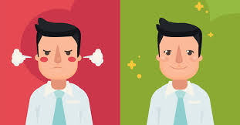
Supporting those Experiencing Emotional Dysregulation
Try to be in the moment, try to calm your nervous system
Change location?
Consider accepting how you feel
Consider practicing mindfulness
Try to engage in stress management
The ABC – Antecedents, Behaviour (Manifestation), Consequences (The Impact)
Be aware of triggers
Listen to colleagues
Provide a psychologically safe culture
The language of inclusion

Slide 19
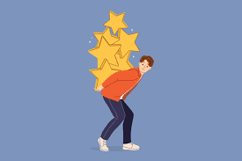
Perfectionism
Perfectionism - setting excessively high standards for oneself and others in a relentless pursuit of flawlessness. Perfectionists may become very self-critical and upset when they feel they have fallen short in some way.
Need for order and control. Need to do things perfectly in order to avoid chaos and uncertainty, which leads to anxiety.
Pressure to conform to social norms and expectations.
Perfectionism may also be tied to the autistic person’s identity.
Procrastination: People who are perfectionists may avoid starting tasks because they are afraid of not being able to do them perfectly.
Social isolation: People who are perfectionists may be afraid of making mistakes, which can lead them to avoid social situations. This can lead to social isolation, which can have a negative impact on mental and emotional health.
Burnout: Perfectionists may be reluctant to ask for help, as they may feel like they need to do everything themselves in order to be perfect. They may also try to perform like neurotypical people, even when they are lacking the bandwidth and push themselves beyond their capabilities, leading to burnout.

Slide 20
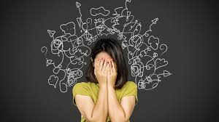
Catastrophising
“Catastrophising is when you are anxious about a situation and that anxiety leads your brain to ruminate on a potentially disastrous outcome.”
(Purple Ella, The Autism Show, 2017)
“It’s when your manager taps you on the shoulder saying they need a word – and your brain goes straight to I’m going to lose my job”
Developing self-understanding about tendency to catastrophise can be an important step towards managing it.
Making adjustments by using clear and direct communication with autistic people, to help avoid the individual going straight to worst case scenario.
Examining the chain of catastrophe by breaking down the scenario in a flowchart style and looking at why the worst case scenario might not happen.
Trying to remove emotion and look at the facts, alongside using key sentence such as ‘are there any actions I can take to reduce the likelihood of the negative outcome?’

Slide 21


Autistic Burnout…
“Autistic burnout is a syndrome conceptualised as resulting from chronic life stress and a mismatch of expectations and abilities without adequate supports. It is characterised by pervasive, long-term (typically 3+ months) exhaustion, loss of function, and reduced tolerance to stimulus.”
Reasons for Burnout
Masking their autistic traits, for example by suppressing autistic behaviours, pretending to be non-autistic, or working very hard to act in a non-autistic way.
Difficult or unreachable expectations from family, school, work, or society in general.
Stress from living in a world not set up to accommodate autistic people, for example managing the stress of having to be in noisy environments.
Life-changes and transitions that are stressful for anyone, for example transitioning from school to work, experiencing a mental health crisis, or the death of someone close.

Slide 22
Part 3
Autism Friendly Working Practice

Slide 23

Creating Autistic Friendly Working Style
Be aware of your own unconscious bias and judgements
Encourage psychological safety at work, this can help colleagues feel comfortable to be themselves.
Understand that we have different ways to communicate – get educated
Create alternative pathways of support for those who may find certain types of communication a challenge
Buddy system
Time out for emotional dysregulation and overwhelm
Check environments are not over-stimulating
Be clear with communications, be specific not asking for a ‘catch-up’ or a ‘chat’
Give emails specific titles, try not to let email trails go on too long with lots of add-ons

Slide 24
The Lived Experience…
‘It’s strange days for our community at the moment, the one thing I would say is be kind… We have a lot to offer and we can be very gifted and talented, let’s not wrongly judge and be prejudiced about our wonderful Autistic Community, I want us to be proud of who we are! ’
Ben

Slide 25
Thank You & Questions
donna@neurobox.co.uk

