Slide 1

wellbeing
Workplace ergonomics
and your
Notes:
Person Into:
HD: Physio, OH, interest Ergonomics; postural & ergonomic Ax. Post graduate study. HWB at core of what I do
TB: working in H&S for over 23 years, Ergonomist & does DSE Ax for UHD. Primary concerns staff safety and wellbeing
Today: Workplace ergonomics and your wellbeing
Ergonomics is not just about furniture
Its about how your whole environment; physical and mental shapes your wellbeing [and productivity]
To do that we’ll look at what ergonomics is, explore the things that can affect you + practical strategies that could be within your means
So, we might make a mention of chairs, but we are looking way beyond that today
Quick check: are you all in the right session?

Slide 2
Ergonomics = Ergon [work]
Nomos [natural laws]
Physical:
  Physiology
  Biomechanics
  Equipment/tool design
Environment
Cognitive
Psychosocial
Notes:
First up: what is ergonomics: word comes from Greek and changed meaning over the years
Initially related only to physical health and safety to prevent injury
Now developed into a holistic approach: more how we are working, and covers:
Physical:
Biomechanics: Your body in motion - how you move – how forces act on your body: levers, force through joints, effort to hold something, push. pull ,lift, grip
Physiology: your bodys internal responses: what you body is doing at a cellular level: circulation, oxygen delivery,. Metabolism, hormones
Equipment we use or tools – hows its designed – the physicality of it
Environment: Temperature; comfort or safety of too hot, too cold, noise; is it distracting, is it too loud, do you wear ear protectors, can you communicate?, light, how bright is it
Cognitive: how we think, and process information; memorise, learn, process information.
How we perceive and make decisions. Water bottle example
Build mental models and schema to help us short cut processing – reduced the load of thinking [energy required]
Its how we hold information in our brain to use – its why we can, recognise objects, know how to behave in certain situations: restaurant example
Decides where we give our attention, whats important
Psychosocial: social and emotional context
the factors that influence your decisions and beliefs. Affected and influenced by the people around you
Relationships and how they make you feel – how they affect you – dynamics in a department
your expectations [from upbringing, culture] of how to treat and be treated, your health and work beliefs// think about how different generations approach work
EXAMPLE of health belief difference
And these all interact with each other and can drive each other – sometimes helpfully – sometimes not so
So Ergonomics is how humans interact with a system: could be work system, space or people around them. Crucially It’s as much about how people perceive and experience their environment as about the physical setup itself.
If you can optimise the ergonomics: you improve wellbeing and [BONUS] system performance

Slide 3
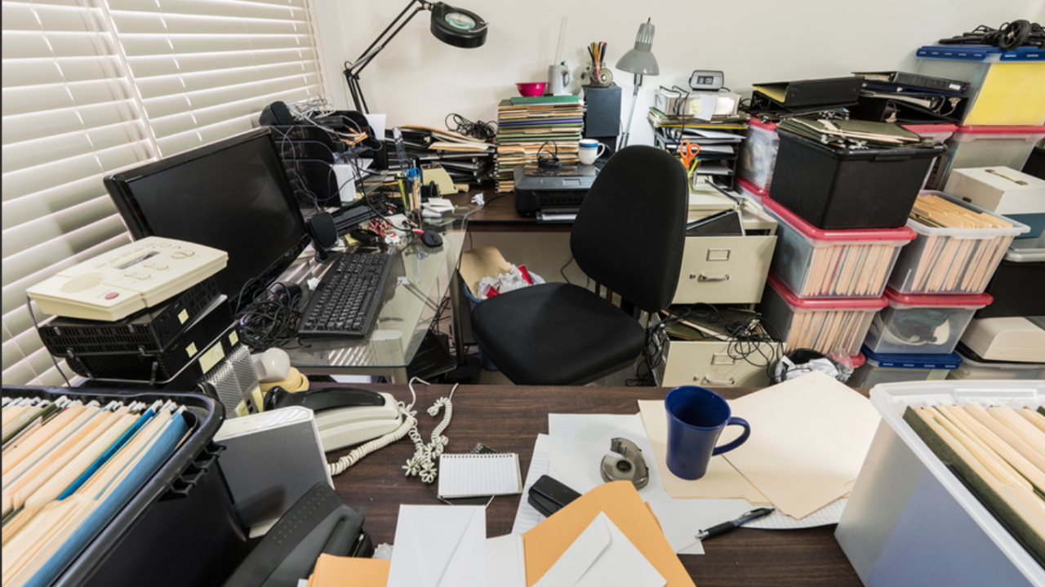
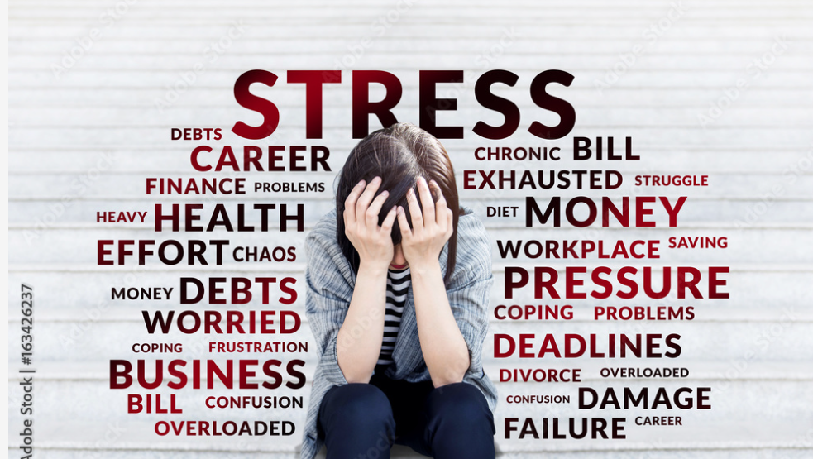
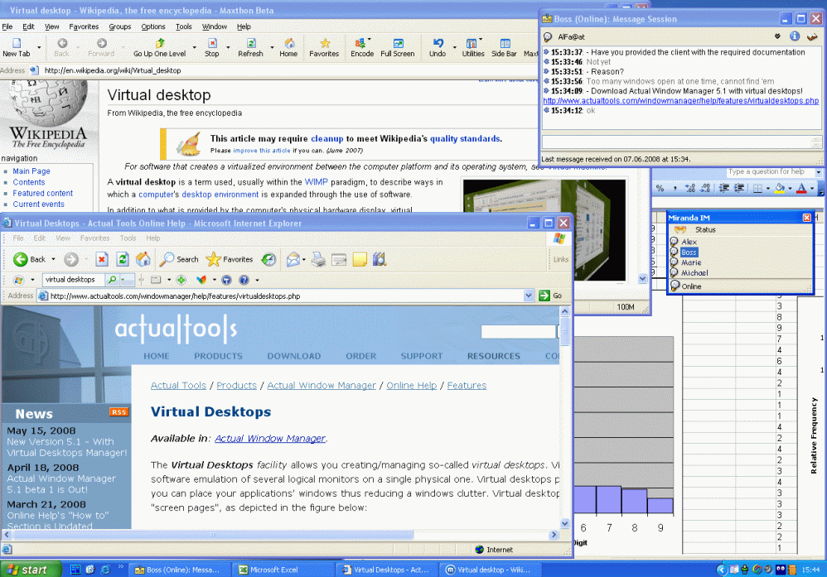
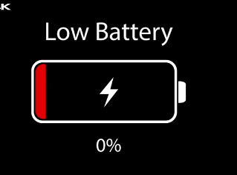
Cognitive overload
Fatigue
Stress
Discomfort
Notes:
Lets talk through some of the how those factors might interact:
Multi direction: individual factors that affect YOU
Discomfort: physical [examples please] is your chair broken, are you sitting awkwardly, is your equipment in reach, on ward/pt care - is the bed high enough, do you reach across you to the phone, are you stood with your arms up for a long time [endoscopy], are you sat down for 8 hours without moving, do your shoulder ache, wrists sore, dry eyes [screens are back lit]
Discomfort affects you physiologically: pain, tense muscles, less circulation
[IMAGE] Anyones desk space [if youre lucky to have a dedicated space] look like this: cant fit under the desk
This isn’t just a physical issues, this affects your cognitive load: if you cant see what you need then you have to spend more energy looking for it – more brain power// that’s your cognitive load and physical discomfort can cause your brain to be distracted, making it harder to think
Cognitive overload happens when your brains got too many demands on it: it cant keep up
The thinking load – the cognitive load increases
It gets more overloaded when you put multiple demands on it: [IMAGE]
The more you ask your brain to multi task and switch between things, distractions the more demand you put on it: this will change – your cognitive capacity- depending on what else youve got going on
Think of cognitive capacity as RAM [computer] it only has so much processing power available to you
The higher the cognitive demand the more likely mistakes and reduced, slower response time// ever noticed it takes you ages to do something when you feel overloaded but it can take just a few mins when youre tip top?
That’s all quite exhausting isn’t it? Think of a day at work where you’ve not physically exerted yourself necessarily but have no energy
Stress factors play a big role here. This could be home or work or anywhere else factors. If youre stressed/anxious chances are you will hold body tension – discomfort, work harder, get more tired, harder to do things
Stress makes you increase your muscle tension before you start: discomfort, brains already full / cognitive capacity low
So it’s a interactive set of cycles
*whats the outcomes of all this?
Exhausted: Burnout
Low productivity – you cant perform/function [in life - that’s in and out of work] – no energy to do your exercises, cook, meet your friends when you get home?
In work affects relationships, people withdraw// haven’t got the energy to face someone today – don’t want to ask about their leave – what do we then avoid and what does that do to us and our relationships// they start to breakdown
Lose team ability to notice and interact with whats around you: your situational awareness reduces- more difficult to work together effectively and less likely to sense check each other
Illness: physiologically stress causes physiological responses and can make you physically unwell// low back pain, shoulder, neck pain – if not looking after yourself other health conditions
Go sick – financial implications: Stress/anxiety likely to increase
Might Leave your job
These can all fuel each other
So what can you do about it?

Slide 4
What can you do?
Physical
Mental
Set up your workstations and environment
Manual handling
Break up physically demanding activities
Move or Rest appropriately
Identify your priorities
Close tabs you don’t need
Reduce clicks
Upskill your IT
Allow cognitive recovery time
Build [mend] your relationships
Notes:
So what can you do about it?
Work is work?
it has to be done
this is the pace
this is how its done
I have no choice
Well Yes…There are organisational limits: checklists you have to do, systems you have to use that you don’t have a say in// and yes all those systemic underlying factors need to be addressed
BUT… the question is – can you make some small changes yourself in how you choose to do things n your role. You are responsible for you
TB: how many small adjustments have you made to see a big difference. Think about the butterfly effect where one small adjustment can make you more comfortable, so you are less fatigued, you pain is better, so you can think more clearly, which is less stressful as you feel more productive and that you have capacity to talk and engage with your colleagues [and your family]
What are your abilities and needs, know your value [as a person & a worker]
You are the best person to find your solutions [not me] but lets think about it
As a team you are best placed to find solutions
You can raise concerns and find solutions as a team
Lets think about physical first:
Sit well: Assess your workstation or environment [includes non desk based]
Think about your manual handling
Think about your physical activities: can you break them up, vary then, plan with your team that tasks rotate. Look at what youre doing – is there a better way – does the environment allow you to do your job in the way it should- if not do/say something
MOVE if you sit in a job: how often?
REST if you move all day
Mental: **Perception**
Identify priorities
Close tabs/applications you don’t need at the same time
Reduce clicks// can you copy/paste
Upskill your IT [make it less cognitively demanding]
Rotate your tasks
Allow cognitive recovery time: get away from the physical or mental demands in your break [take a break]
Build your relationships: mend them – reach out
Consider WFH question: is it helpful – sometimes. But disjoints you from the team: engage with the team// interactions are so valuable for your wellbeing// inclusion needs effort
*recognising these things is important: talk to your manager, engage your team// foster open communications – address some of those things you’ve been avoiding, like talking to the manager you think doesn’t like you
Start those wellbeing conversations

Slide 5
Organisational
Communication
Raise concerns about system barriers
Model healthy behaviours
Notes:
Individual resilience is about looking after you
Team resilience is about relationships
Foster open and authentic communication// we need to really want to listen to each other & engage
Raise concerns
Look at job lists and rotate tasks, support breaks
Raise concerns about system barriers and if you have solutions you see// you do your job all day [and night]. // what can be done for free within the service/system// ?Older persons team checklist 19 forms into 1? It can happen
Model healthy behaviours
some things you cant control// system design doesn’t always allow you to have control over your work. There will be factors you cant address right now – how systems are set up, the design of systems that need to be designed to fit better with us as humans.
BUT address the things you can, raise the things you cant// regaining an element of control back – even what might feel very small can change how you feel// as we know changing how you feel can change your perception and capacity, reduce your thinking about it

Slide 6
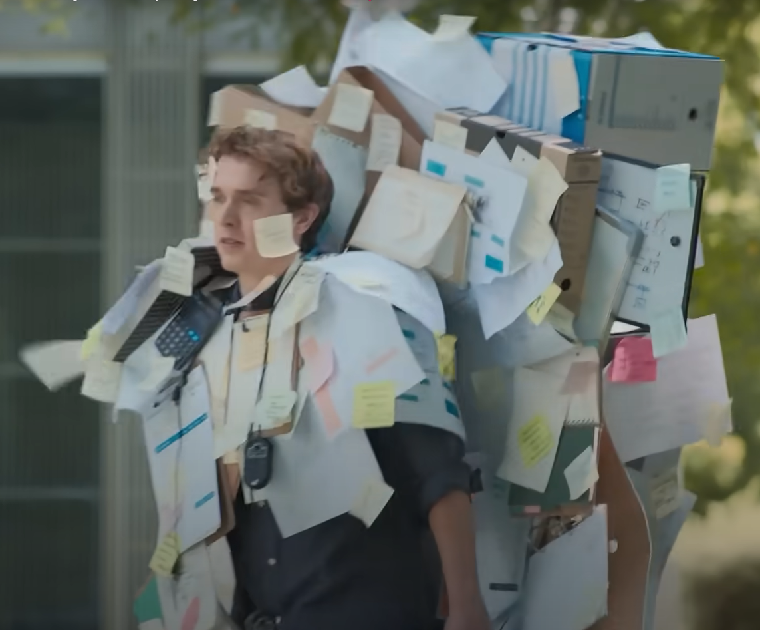
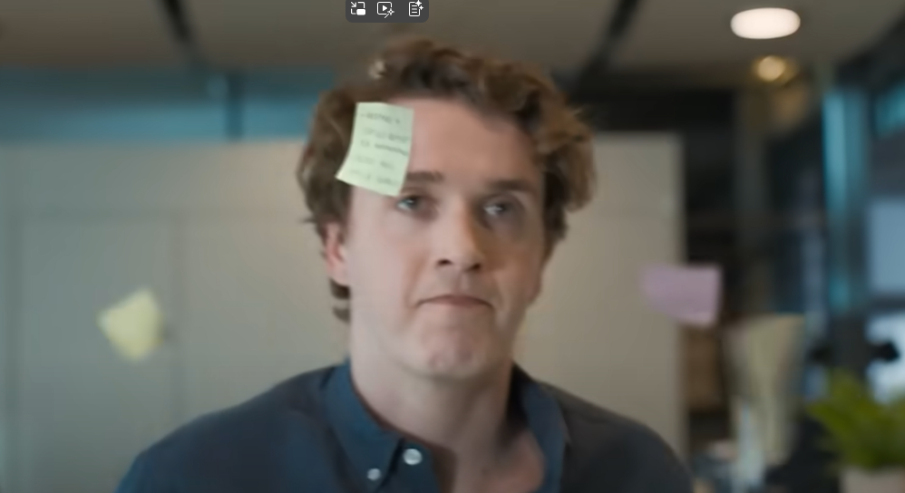
Notes:
Can you get from this? To this? – maybe not get rid of everything! Lets be realistic..

Slide 7
What will you do today?
Notes:
This is your call to action
Your wellbeing is just that – its yours
The impact of ergonomics on your wellbeing in the workplace is vast
As an employee what will you do today: what will you go away and look at or think about, or talk to a colleague, friend, the cat about. What will you empower someone else to go and look do
Managers are also employees – everyone in that team has a personal responsibility to themselves to work to the best of their ability without damaging themselves – but that’s not enough is it?
getting through isn’t enough.. Work to the best of your ability and thrive

