Slide 1
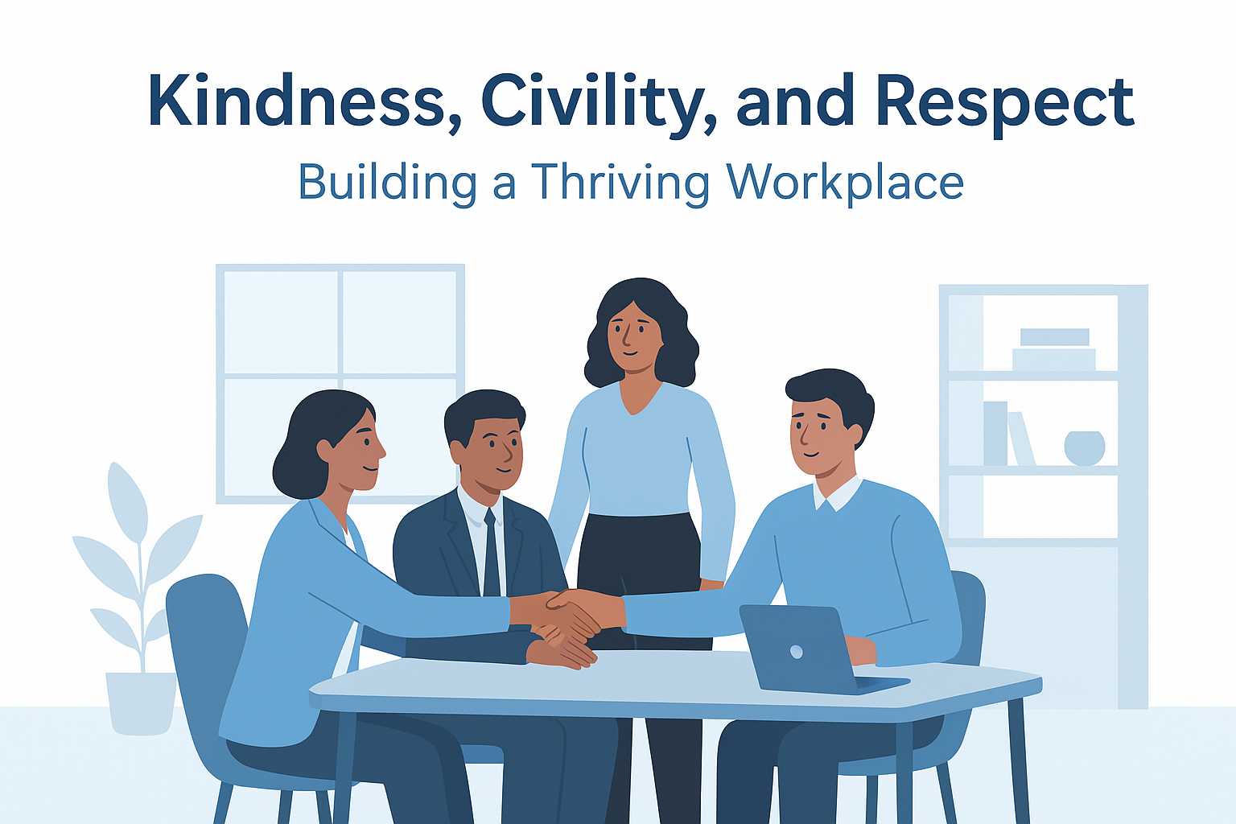
How Behaviours Shape Wellbeing
Kindness, Civility, and Respect in the Workplace

Slide 2
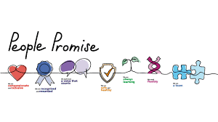
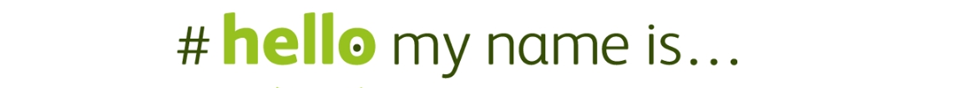
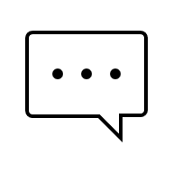


Helen Martin
Helen.martin71@nhs.net
Notes:
Participative – using breakout rooms/polls/chat etc.
Handout for you at the end of the session.

Slide 3
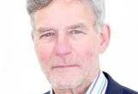
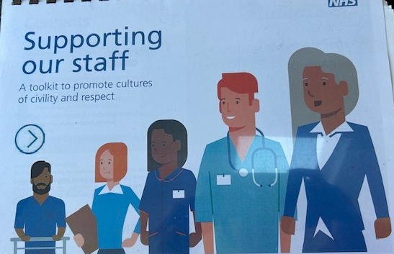
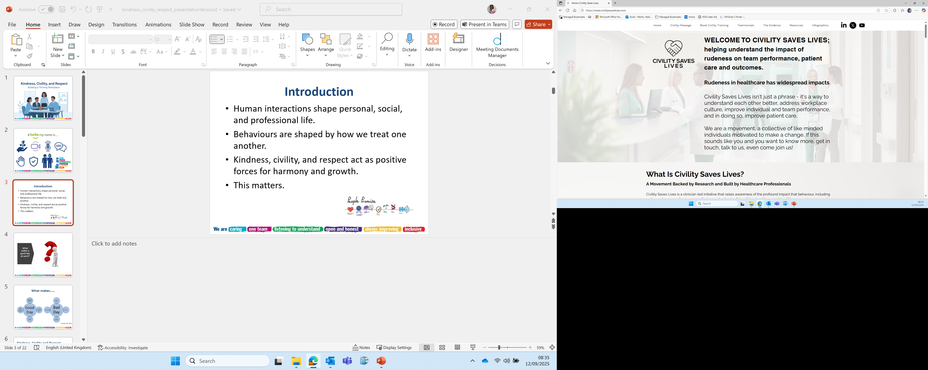
Introduction: Kindness, civility and respect
Human interactions shape personal, social, and professional life.
Behaviours are shaped by how we treat one another.
Kindness, civility, and respect act as positive forces for harmony and growth.
This matters.

Slide 4
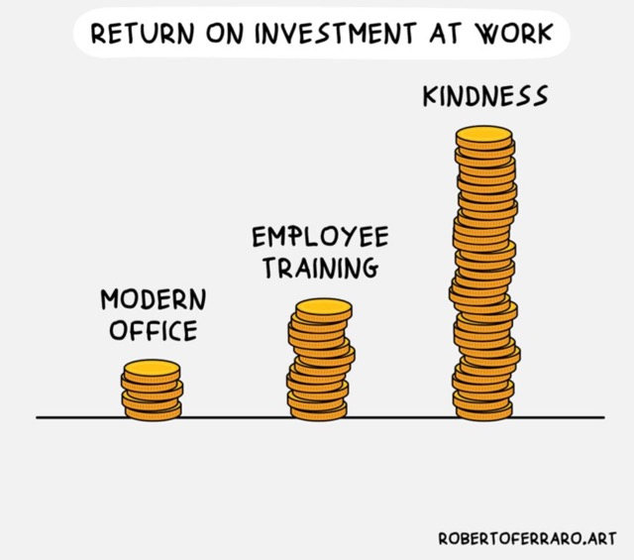

Slide 5
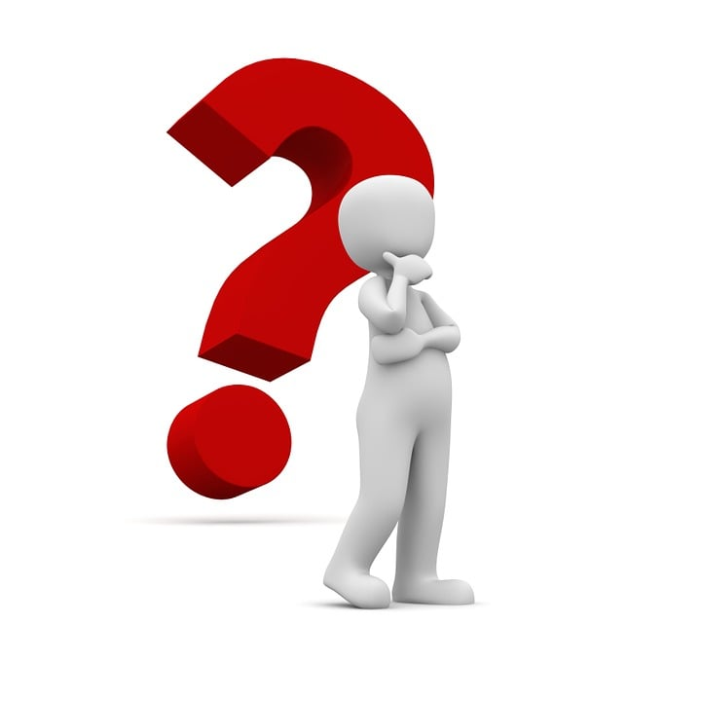
What makes a good day at work?

Slide 6
What makes……
Good Day
Appreciation and positive feedback
Teamwork and kind support
Positive people
Helping others, making a difference
Bad Day
Poor behaviour
rudeness
Lack of teamwork
undervalued
A Kinder Life, 2021

Slide 7
Kindness, Civility and Respect
Behaviour | What is it? | Key Benefit | Mechanism
Kindness | The act of being considerate, generous, and supportive. | Boosts happiness and connection | Neurochemical release (serotonin, oxytocin)
Civility | Politeness, courtesy, and regard for others in behaviour and speech. | Lowers stress and fosters cooperation | Social harmony and safety
Respect | Recognizing the value of others, their rights, and their perspectives. | Builds self-esteem and trust | Validation and mutual dignity
Notes:
How Kindness shapes behaviours:
Encourages empathy.
Reduces conflict.
Inspires reciprocal acts of goodwill.
Sets a cooperative tone
civility shapes behaviour:
- Builds trust and understanding.
- Prevents toxic environments.
- Promotes constructive communication.
Fosters inclusivity and fairness.
- Encourages responsibility and accountability.
- Reduces prejudice and discrimination.

Slide 8

Combined Impact
Creates a culture of safety and belonging
Strengthen teams
better communication
creates resilience in challenges
Encourages collaboration over competition
Shapes behaviours - empathy and appreciation
Supports mental health
EVEN Better: It is contagious

Slide 9
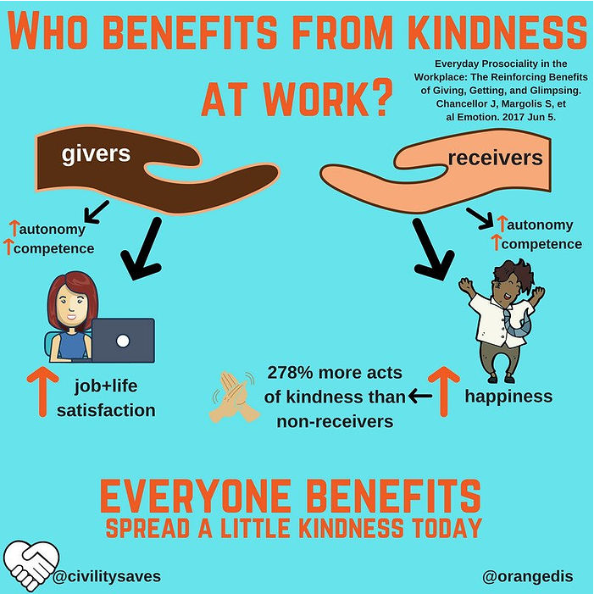

Slide 10
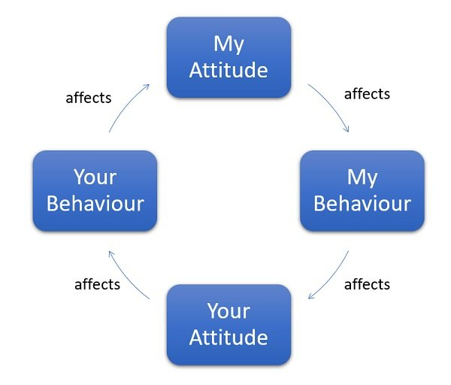
Betari Box
A cycle of attitudes and behaviours between people.
how I think and feel about something
how you think and feel about something
Notes:
Also known as the Cycle of Conflict
Attitude is a state of mind or a mindset then controls how we respond to other people and situations around us. You may have heard attitude used in the context of positive attitude and negative attitude. In its simplest form, attitude is a decision that we make about how we will respond to someone or something. The decision about attitude tends to be an unconscious one. This means that the decision about our attitude is normally made without even thinking about it. This may be based on how we are feeling at the time. Because it’s unconscious we don’t have self-awareness. And, in many cases, the way we are feeling (for example negative) will justify the choice and behaviour in our brain, so as far as we are concerned everything is OK and we acting normally. This isn’t what other people see though.
Behaviour is the outwards actions that we show through our actions, for example through body language. These behaviours are what other people use to form perceptions and opinions about us and ultimately how to respond to us.

Slide 11
Example
My Attitude: I am happy after receiving some good feedback from my manager
My Behaviour: I am more patient with the team, happy to answer queries.
Your Attitude (Team): The team feel secure to raise issues and discuss through thoughts and ideas. They feel valued.
Your Behaviour (Team): Productivity increases, less mistakes, willing to try new things, increased patient satisfaction
Positive energy fuels stronger teamwork and productivity.

Slide 12
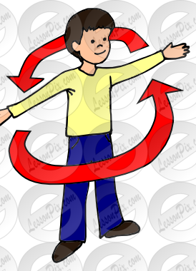
Exercise
Can you think of a time
My Attitude is negative
My Behaviour is then negative
Your Attitude is negative
Your Behaviour is negative

Slide 13
Example
My Attitude: I start the day annoyed and impatient. I am late for work
My Behaviour: I answer a question from a team member with a short and abrupt tone, rushing through responses.
Your Attitude (Team): The team feel dismissed unvalued, frustrated and frightened.
Your Behaviour (Team): The team avoid me, productivity decreases, become defensive and even rude, which feeds back into my irritation.

Slide 14
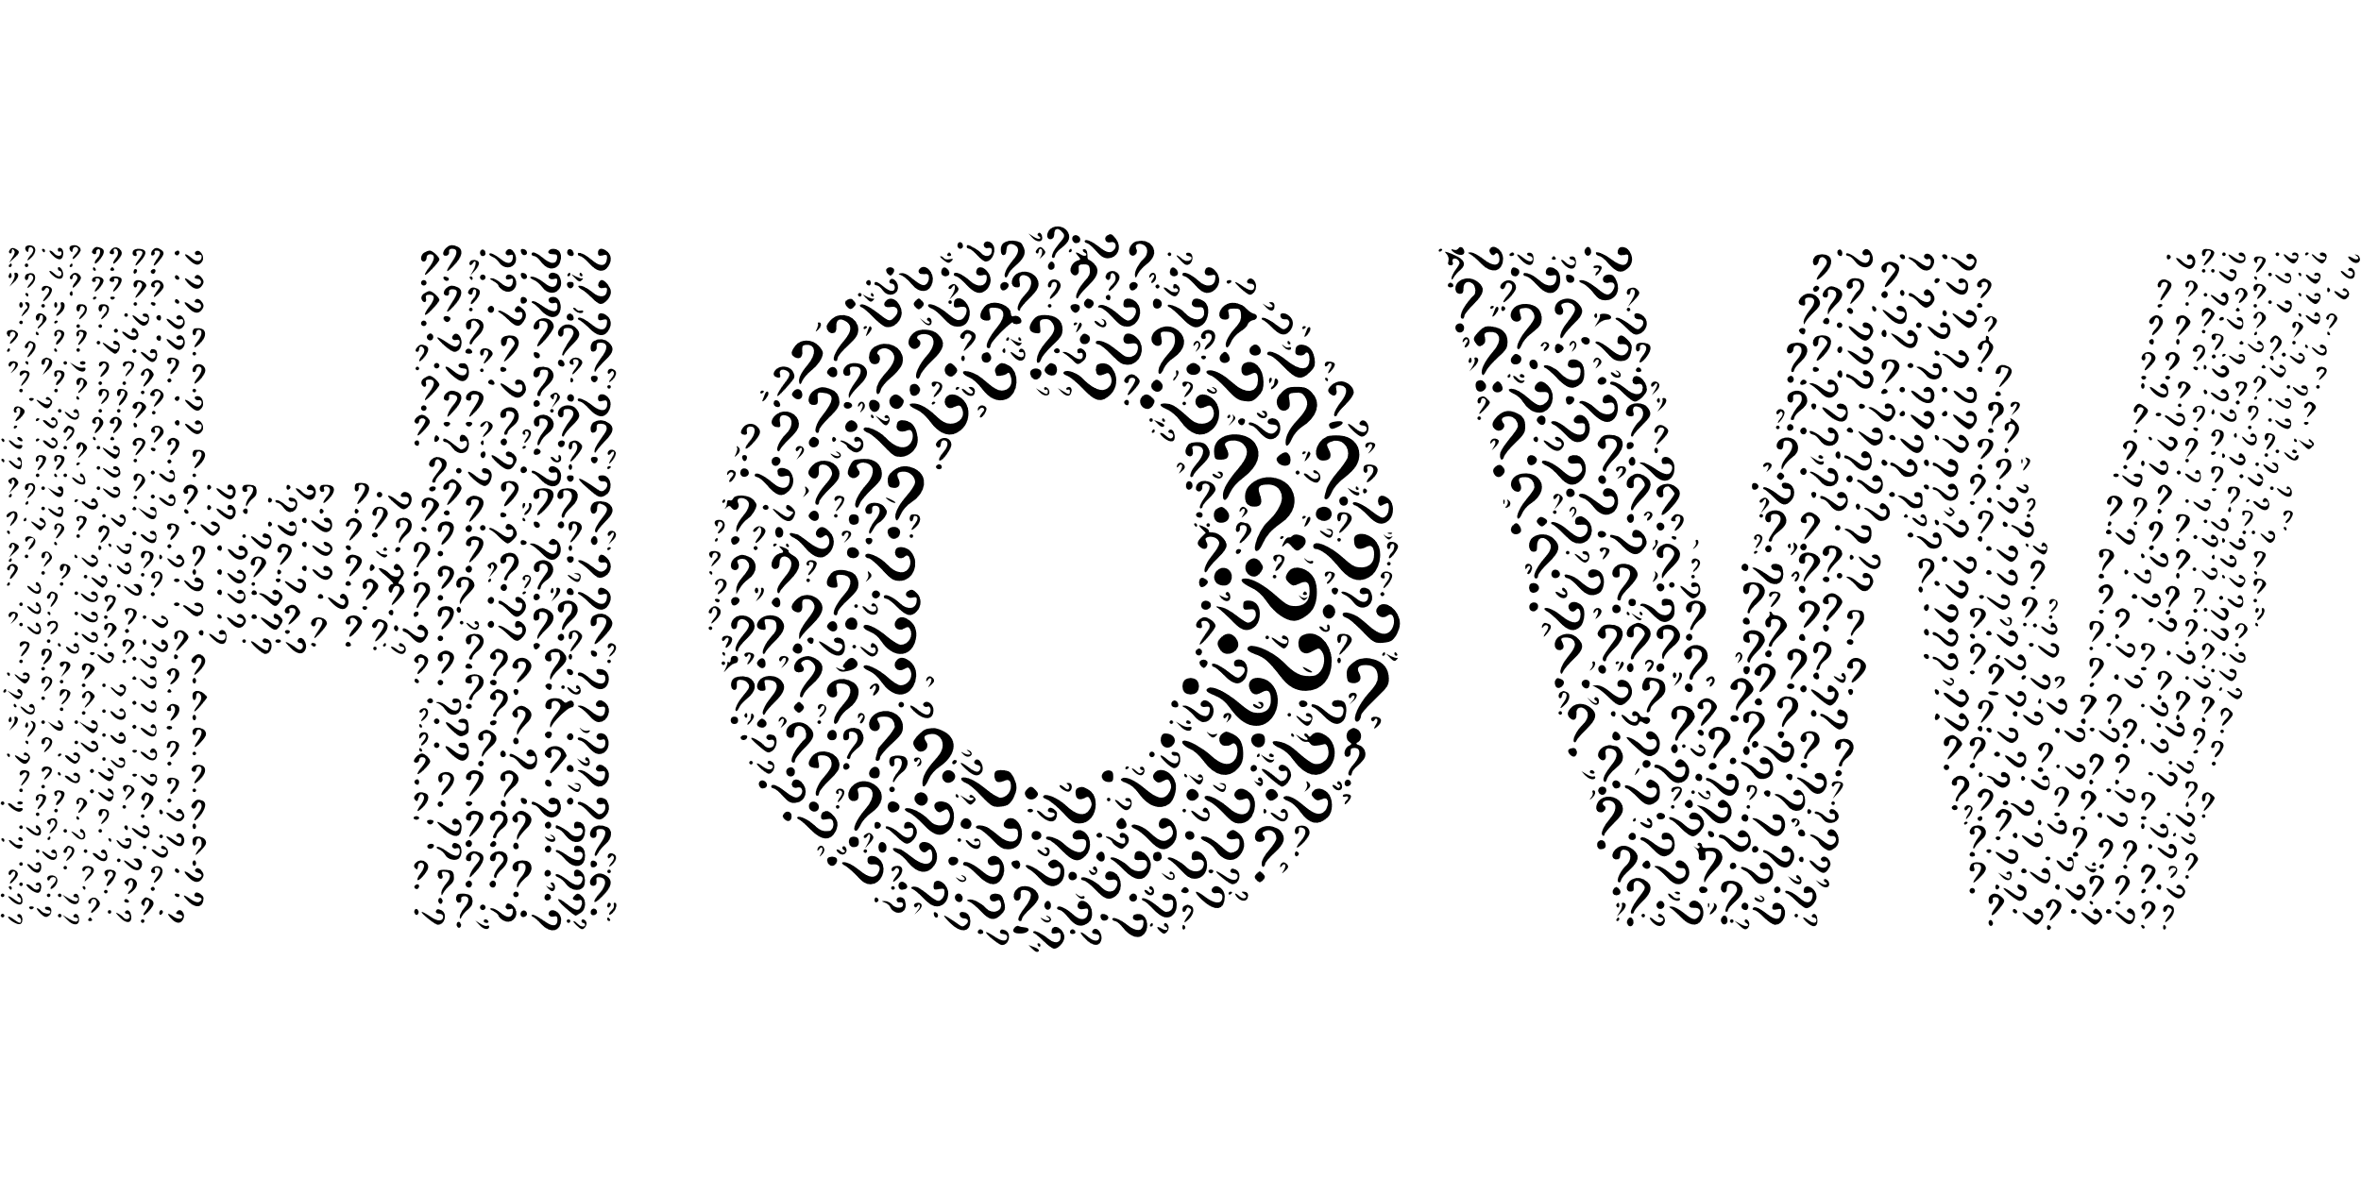
Interrupt the Cycle

Slide 15
Betari Box
Decision Pt
how I think and feel about something
If we are able to choose our attitude at the decision point we make much better decisions about our actions and behaviour. This will then begin to have a positive influence on others.

Slide 16
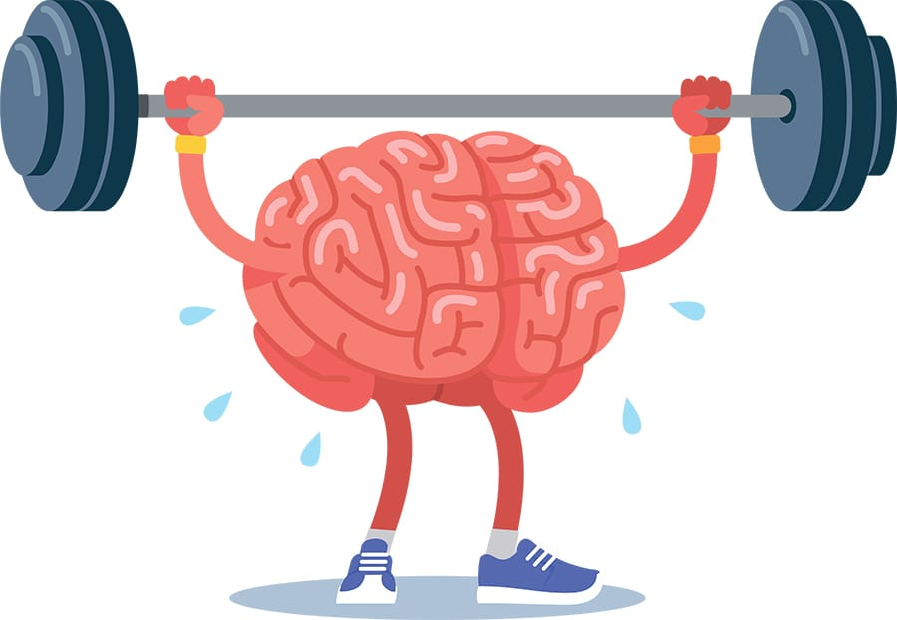

Notes:
We need to do something consciously to remind ourselves to make a positive decision
Engage the brain
Pause and reflect

Slide 17
Break the Cycle
Take a deep breath
Count to 5
Mindfulness
Tighten, then relax
Movement – a quick walk, going up and down the stairs, even clamping your middle finger and thumb together….any movement reduces stress.
Take notice of our body
Say something in your mind
Perceptual Positions- the exercise of understanding the other person's perspective and feelings.
Notes:
If we remind ourselves to do one of these things, we are doing something conscious.
This reminder now means we are thinking more logically and consciously

Slide 18
Other Practical Strategies
Model desired behaviour
Positive reinforcement
Team rituals and feedback
Behaviour Charter

Slide 19
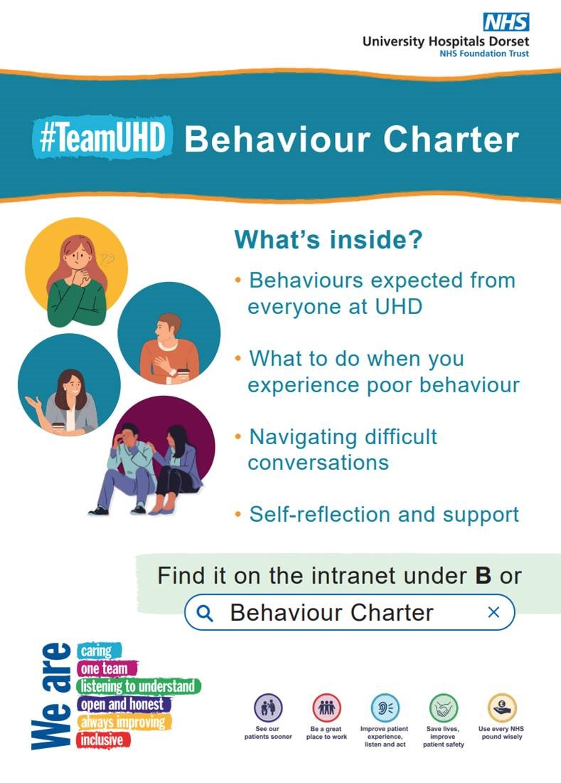
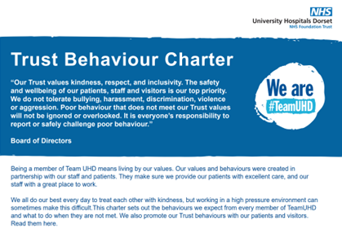
UHD Behaviour Charter

Slide 20

Feedback with kindness, civility and respect
Informal/Cup of Tea conversations
Possible openings
“I have something that I would like to discuss that I think will help us work better together”
Be specific, not vague
Focus on behaviour, not character
Make it constructive
Use “I” statements
Invite dialogue

Slide 21
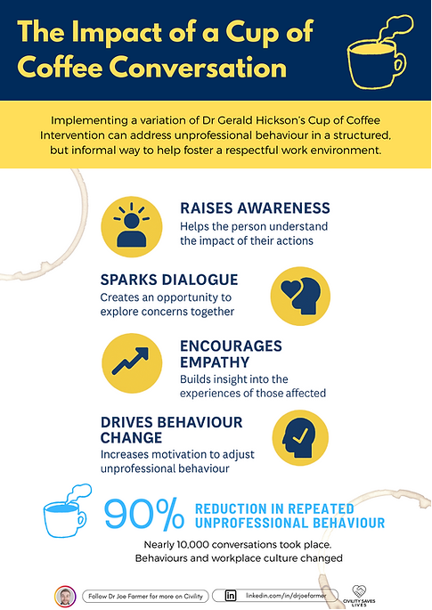

Slide 22
Why Bother…..
Boosts morale and motivation: A positive, respectful environment makes people more enthusiastic about their work.
Improves communication: Civility encourages active listening and open dialogue, making problem-solving easier.
Enhances productivity: Reduced stress and stronger relationships translate into better focus, efficiency, and creativity.
👉 In short: kindness fuels trust, civility reduces friction, and respect builds stability—together, they create a healthier, more effective workplace where people can thrive.

Slide 23
Conclusion
Kindness, civility, and respect are not just values—they are behavioural shapers.
They influence how individuals interact, resolve conflict, and build lasting bonds.
“How we treat others defines who we are.”

Slide 24

Call to Action
• Practice small daily acts of kindness.
• Choose civility in disagreements.
• Respect differences and diversity.
• Together, we can shape better behaviours and stronger communities.
This Photo by Unknown Author is licensed under CC BY-NC-ND

